Slide 1
WELLBEING
School counselor Souca Laura

Slide 2
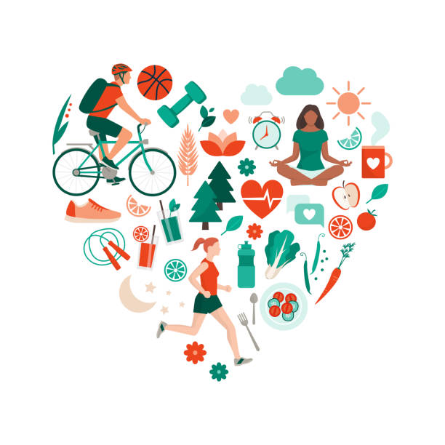
As human beings, we are always looking for ways to find happiness, but what if we don't need to find happiness, just because we realize it's in us?
This is the theory of wellbeing by Martin Seligman

Slide 3
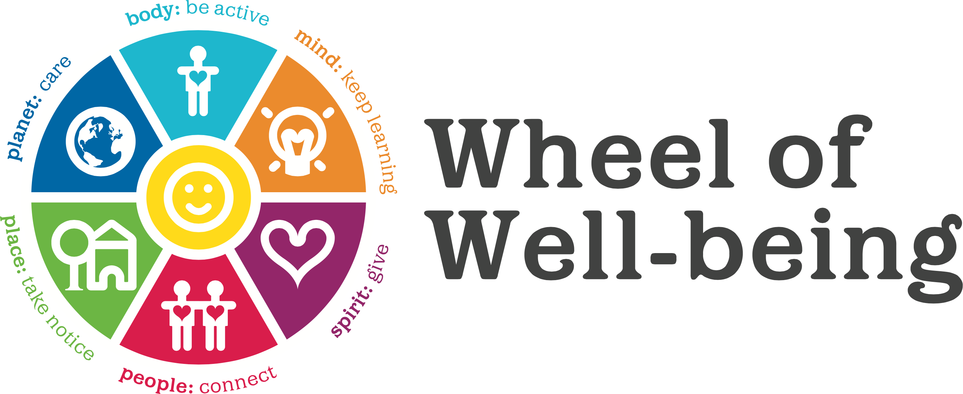

Slide 4
What is WELLBEING?
WELLBEING is the ability to be present, aware and capable to build healthy relationships with yourself and with those around you.
WEELBEING is the central subject of Positive Psychology, whose goal is to discover the factors that contribute to human well-being.
Martin Seligman, for example, suggests that these factors consist in having positive emotions, being engaged in an activity, having good relationships with other people, finding meaning in one's life and a sense of accomplishment in the pursuit of one's goals, all this being transposed into PERMA model.

Slide 6
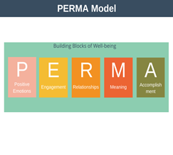
What would happen if you did an exercise every day to increase your well-being?
WELLBEING COMPONENT | Activities
P | Listen to music, visit your loved ones, go hiking.
E | Play a game you like most but forgot about it.
R | Send your friends photos of what you have done lately, call your friends/family members to congratulate them on a recent success.
M | Involve your family in your games, help your little brother with a project to surprise your family.
A | Make an Award Board with all the awards received in the past 5 years.

Slide 7
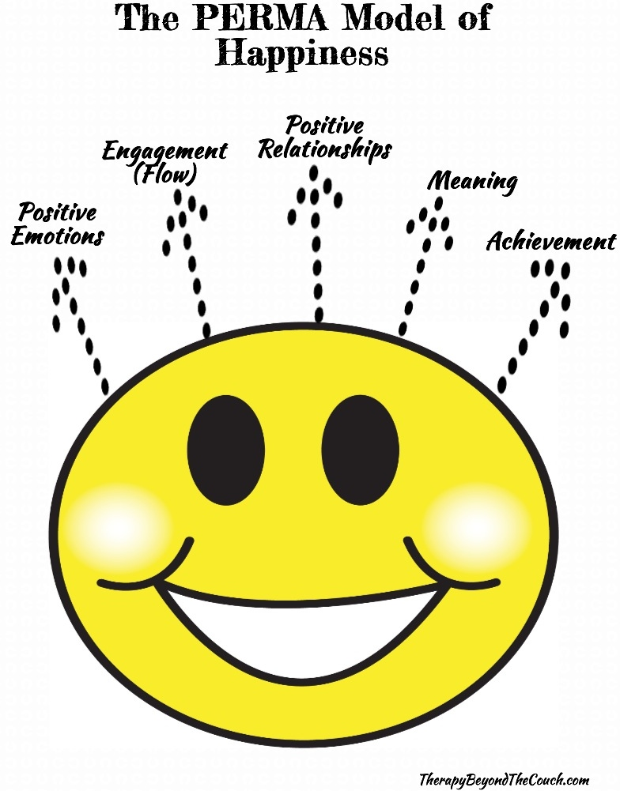

Slide 8
10 Simple Ways to Find Happiness
1. Be with others who make you smile. Studies show that we are happiest when we are around those who are also happy.
2. Hold on to your values. What you find true, what you know is fair, and what you believe in are all values. Over time, the more you honor them, the better you will feel about yourself and those you love.
3. Accept the good. When good things happen, even the very little ones, let them in.
4. Imagine the best. Don’t be afraid to look at what you really want and see yourself getting it. The truth is that imagining getting what you want is a big part of achieving it.

Slide 9
5. Do things you love. Maybe you can’t play football every day or play with your friends, but as long as you get to do the things you love every once in a while, you will find greater happiness.
6. Find purpose. Those who believe they are contributing to the well-being of humanity tend to feel better about their lives. Most people want to be part of something greater than they are, simply because it’s fulfilling.
7. Listen to your heart. You are the only one who knows what fills you up and for that try to make the best decisions after talking with your family about them.

Slide 10
8. Push yourself, not others. It’s easy to feel that someone else is responsible for your fulfillment, but the reality is that it is really your charge. Once you realize that, you have the power to get where you want to go. Stop blaming others or the world, and you’ll find your answers much sooner.
9. Be open to change. Even if it doesn’t feel good, change is the one thing you can count on. Change will happen, so make contingency plans and emotionally shore yourself up for the experience.
10. Bask in the simple pleasures. Those who love you, treasured memories, silly jokes, warm days, and starry nights—these are the ties that bind and the gifts that keep on giving.

Slide 11
ACTIVITY LINKS
https://wordwall.net/play/15814/789/756
https://wordwall.net/play/15813/610/395
https://wordwall.net/play/16043/015/610
https://www.jigsawplanet.com/?rc=play&pid=1e963884d413
https://www.jigsawplanet.com/?rc=play&pid=0dca249b5d32

