Slide 1
GAMES FOR THE FUTURE

Slide 2
Hi everybody!
My name is Eros. I’m portuguese, I’m 10 years old and I am from class B of the fourth grade.
This lady is teacher Cristina, and she is the school headmistress.

Slide 3
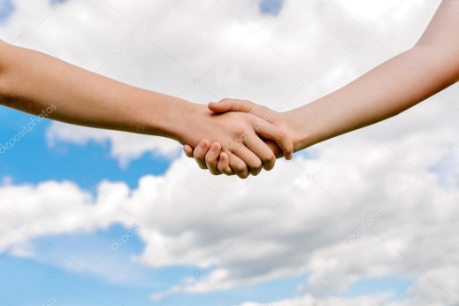
I think this is the right time for everybody introduces himself, don’t you think?

Slide 4
Please tell us:
your name;
your age;
your country.

Slide 5
Thank you!
I really liked to learn a bit about you.

Slide 6
Now, please watch this movie with me.

Slide 7
https://www.youtube.com/watch?v=LT9z2CTuKLA

Slide 8
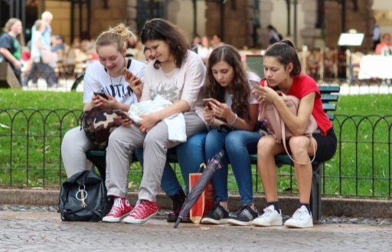
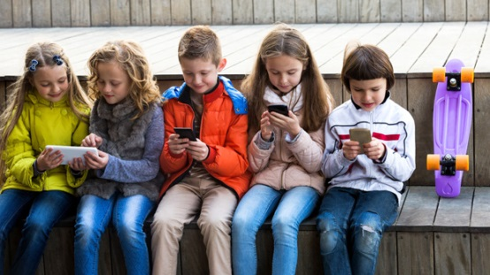
We live in a time where technologies are part of our lives.
However, we can’t let them rule us.

Slide 9
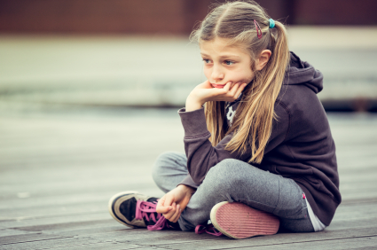
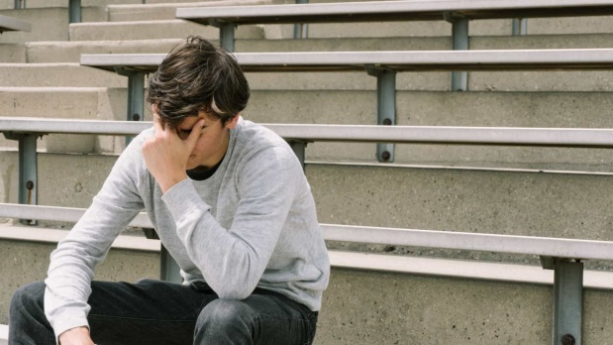
If we think for a while, many bullying situations happen on-line.

Slide 10
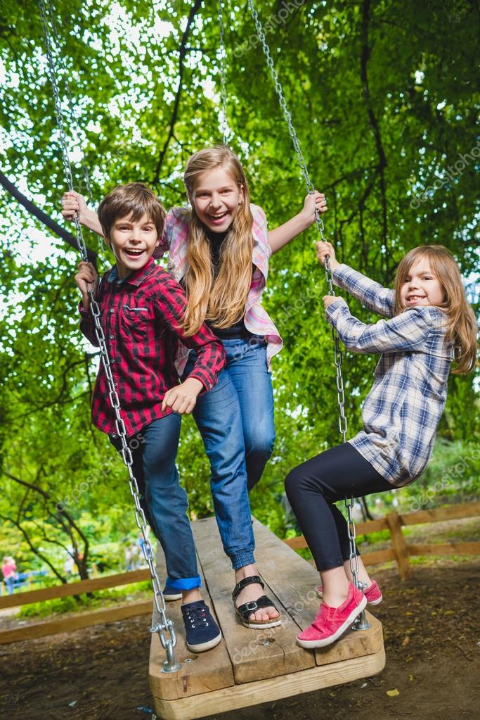
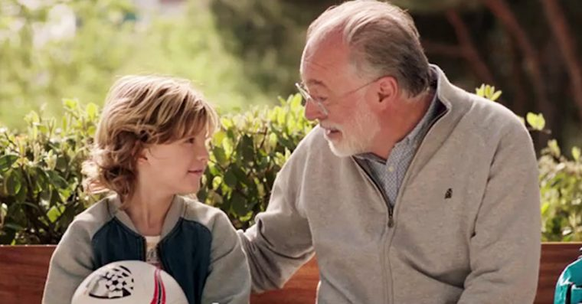
We have to fight against that and to appreciate the company of our families and friends.

Slide 11
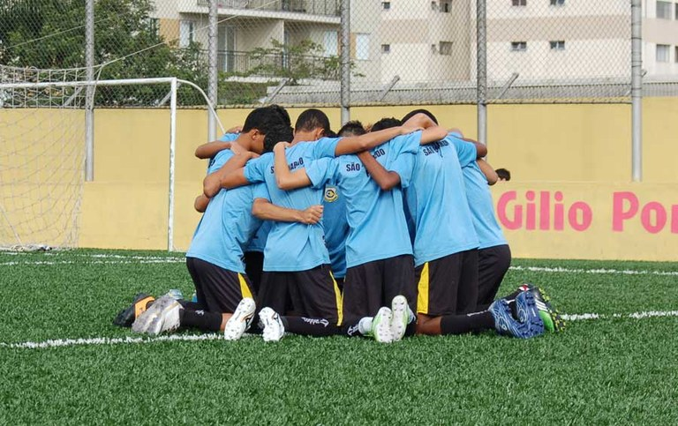
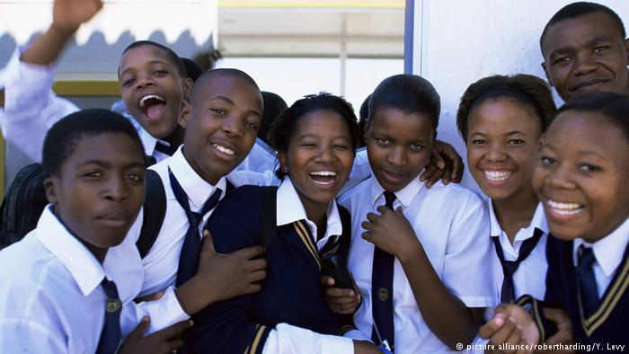
I mean, being with them for real!

Slide 12
Now, me and the headmistress, teacher Cristina are going to give you a coloured sticker so you can group with others with the same colour.
Of course your teachers can accompany you.

Slide 13
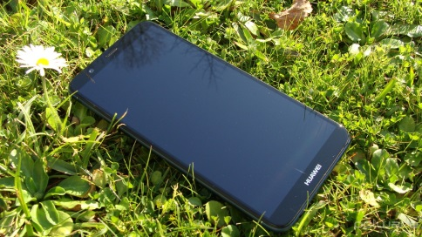
YOU ARE INVITED TO PLAY THE FUTURE GAMES
We will play together in real interaction.
Let’s get to know each other a little better, so I have one rule: store your phones away and
LET THE GAMES BEGIN!!!
Come with us.

