Slide 1
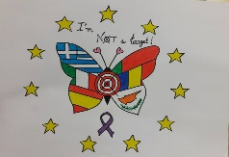
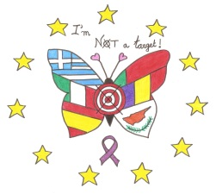
PROJETO ERASMUS +
“I AM NOT A TARGET”
PORTUGAL MOBILITY
TITLE: CYBERBULLYING IN EVERYDAY LIFE
18TH -22TH March 2019

Slide 2
PROJETO ERASMUS + “I AM NOT A TARGET”
Friendship Bracelets
One of the activities carried out in Mobility Week in Portugal was called Bracelets of Friendship.
In an environment of sharing, help and friendship, the six countries gathered (Greece, Cyprus, Romania, Spain, Italy and Portugal) painted national flags and built bracelets that were placed on each participant's wrist.

Slide 3
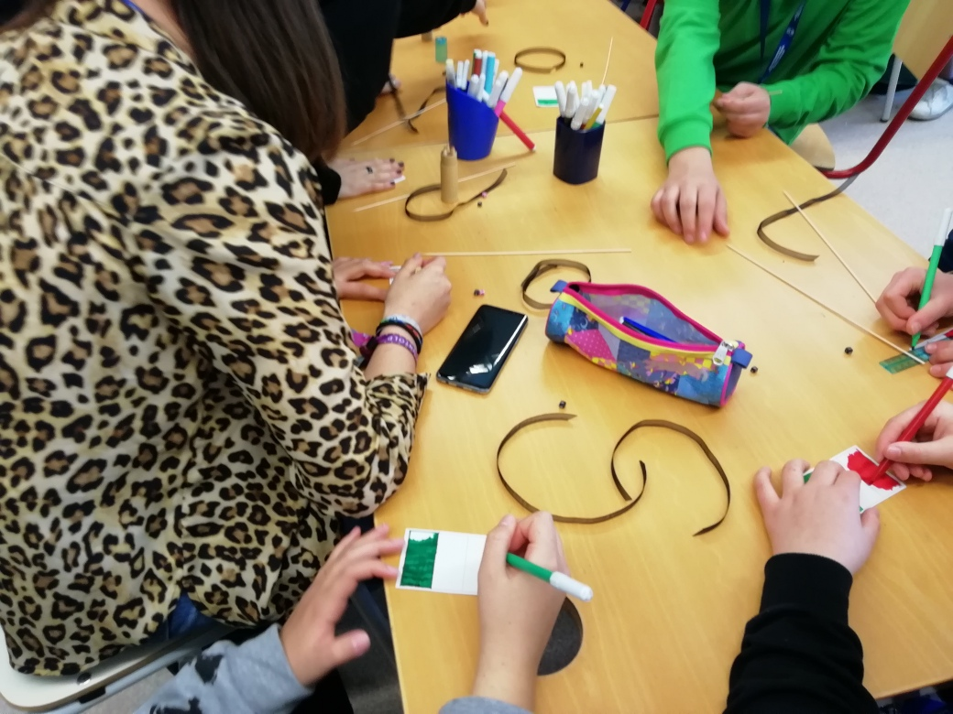
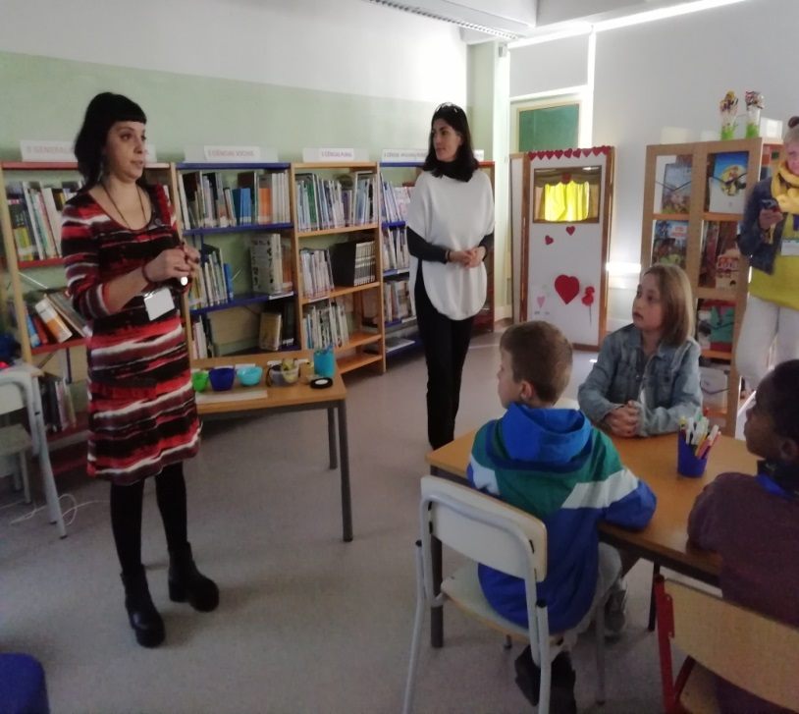
Here are some images of this special moment.

Slide 4
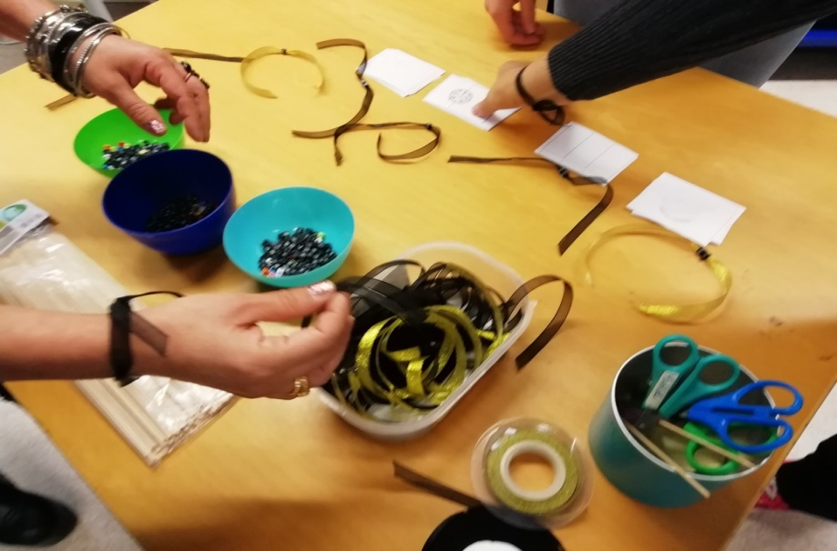
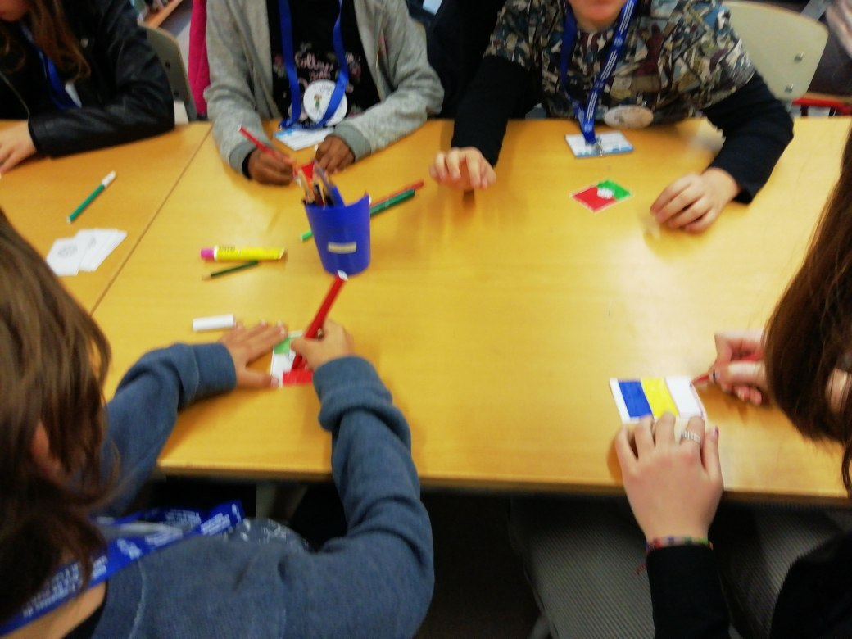

Slide 5
