Slide 2
Students can define cyberbullying and recognise examples of it
Students can identify which actions cross the line between ‘banter’ and cyberbullying
Students can find help and know who to speak to if they’re worried about something online
Students can give advice about how to prevent or stop cyberbullying

Slide 3
Story “The Maligned Wolf”
Starter discussion
Watch film
Discussion questions
---------------------------------------
Activity 1: Walking debate
Plenary

Slide 4
The Maligned Wolf

Slide 5
What is
bullying?
All bullying is aggressive, but not all aggression is bullying.
Comment the sentence

Slide 6
Bullying
Unwanted, aggressive behavior among school aged children that involves a real or perceived power imbalance.
The behavior is repeated, or has the potential to be repeated, over time.
Both kids who are bullied and who bully others may have serious, lasting problems.
In order to be considered bullying, the behavior must be aggressive and include:
An Imbalance of Power: Kids who bully use their power—such as physical strength, access to embarrassing information, or popularity—to control or harm others. Power imbalances can change over time and in different situations, even if they involve the same people.
Repetition: Bullying behaviors happen more than once or have the potential to happen more than once.

Slide 7
What is
cyberbullying?
Task: In pairs, write a definition of cyberbullying
2 minutes

Slide 8
How is cyberbullying different to physical bullying? Is it worse?
Can you name some adjectives that would describe someone who is being cyberbullied?
#
!!
Why would someone be cyberbullied?
What would be the consequences for you, others involved, your family or your friends if the school found out you had been cyberbullying another student?
????
Can you give examples of cyberbullying?

Slide 9
Watch “Crossing the Line”

Slide 10
Is this film realistic? Could a similar situation happen in your school?
The title of this toolkit is called ‘Crossing the Line’. In this film, where do you think the line was crossed?
Why do you think the adolecent was bullied? Why do you think anyone is bullied?
Notes:
Suggested answers for teachers
2) When Charlie called Jason a gaymer, when they took pictures of him, when they spread pictures around?
3) Jason was new, Charlie was threatened by him, Jason seemed different?
4) He should have screenshotted the mean messages online, he should have told someone sooner, he should have remained calm and not retaliated; he ignored the messages after, he eventually told his sister

Slide 11
How did he respond to the cyberbullying? What could he have done differently? What did he do well?
Could him have done anything to stop the bullying? If yes, what could he have done?
What advice would you give to someone if they are being cyberbullied?
Notes:
Suggested answers for teachers:
4) He should have screenshotted the mean messages online, he should have told someone sooner, he should have remained calm and not retaliated; he ignored the messages after, he eventually told his sister
5) Tell a trusted adult sooner, blocked the users, reported the comments, not retaliated

Slide 12
How many people bullied him?
Are those who laughed along at the memes/funny pictures also involved in cyberbullying?
There are many in the film who see what is happening but say nothing to help him. They are called bystanders.
Why do you think they remained quiet?
Notes:
Suggested answers for teachers:
2) Bystanders: Jason’s other friends (Jenna, Ben), Remain quiet? For fear Charlie might target them, not to seem like a snitch, not to be seen like you can’t take a joke

Slide 13
Activity -
Walking debate
On either side of the room you will see a sign saying ‘CYBERBULLYING’ or ‘JUST A JOKE.’ You need to decide if the social media posts you are about to see, cross the line from being a joke to cyberbullying.
The context won’t always be clear, so imagine you are just coming across these posts online and you don’t know the people involved.
10 minutes

Slide 14
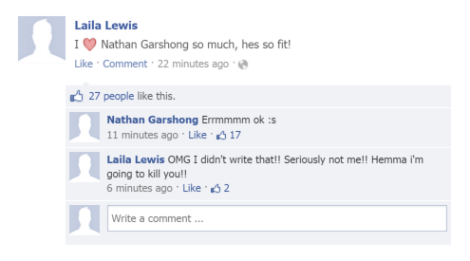

Slide 16
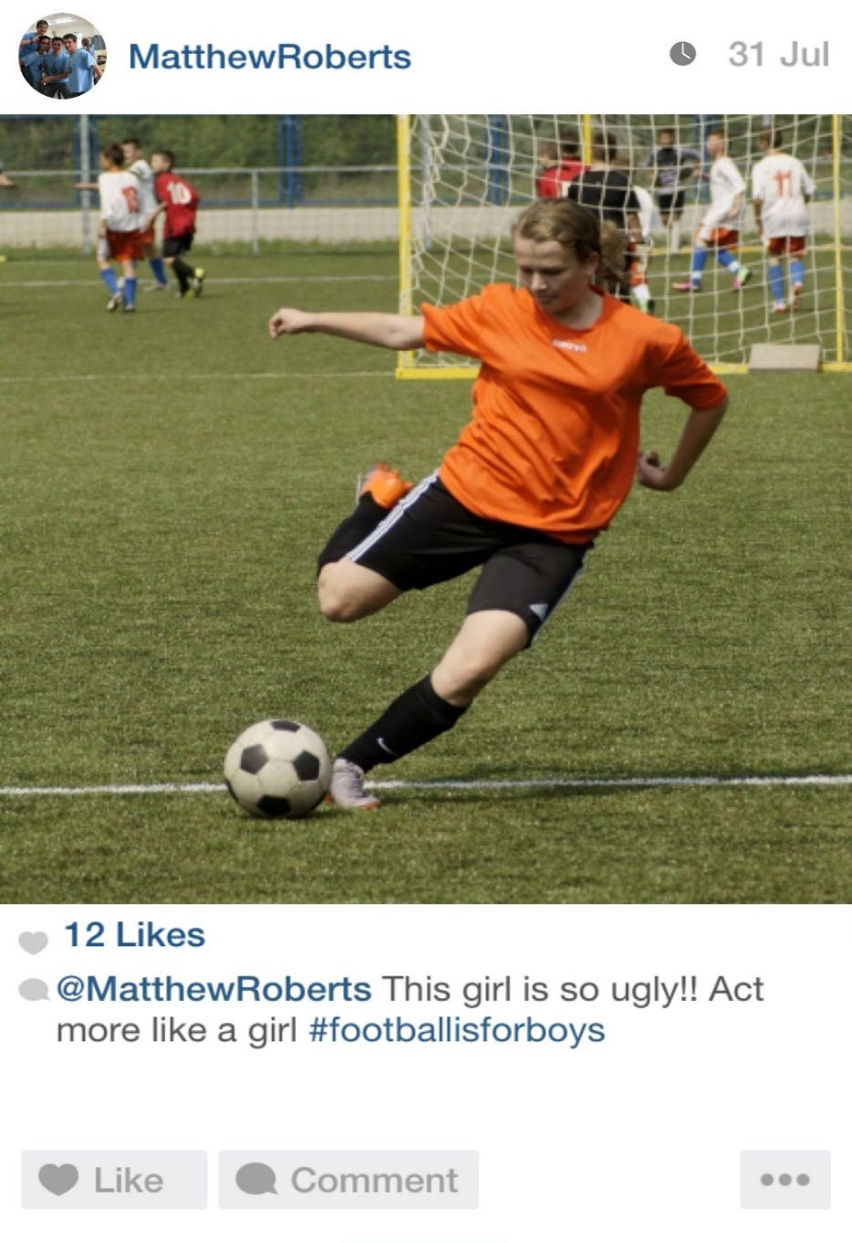

Slide 17
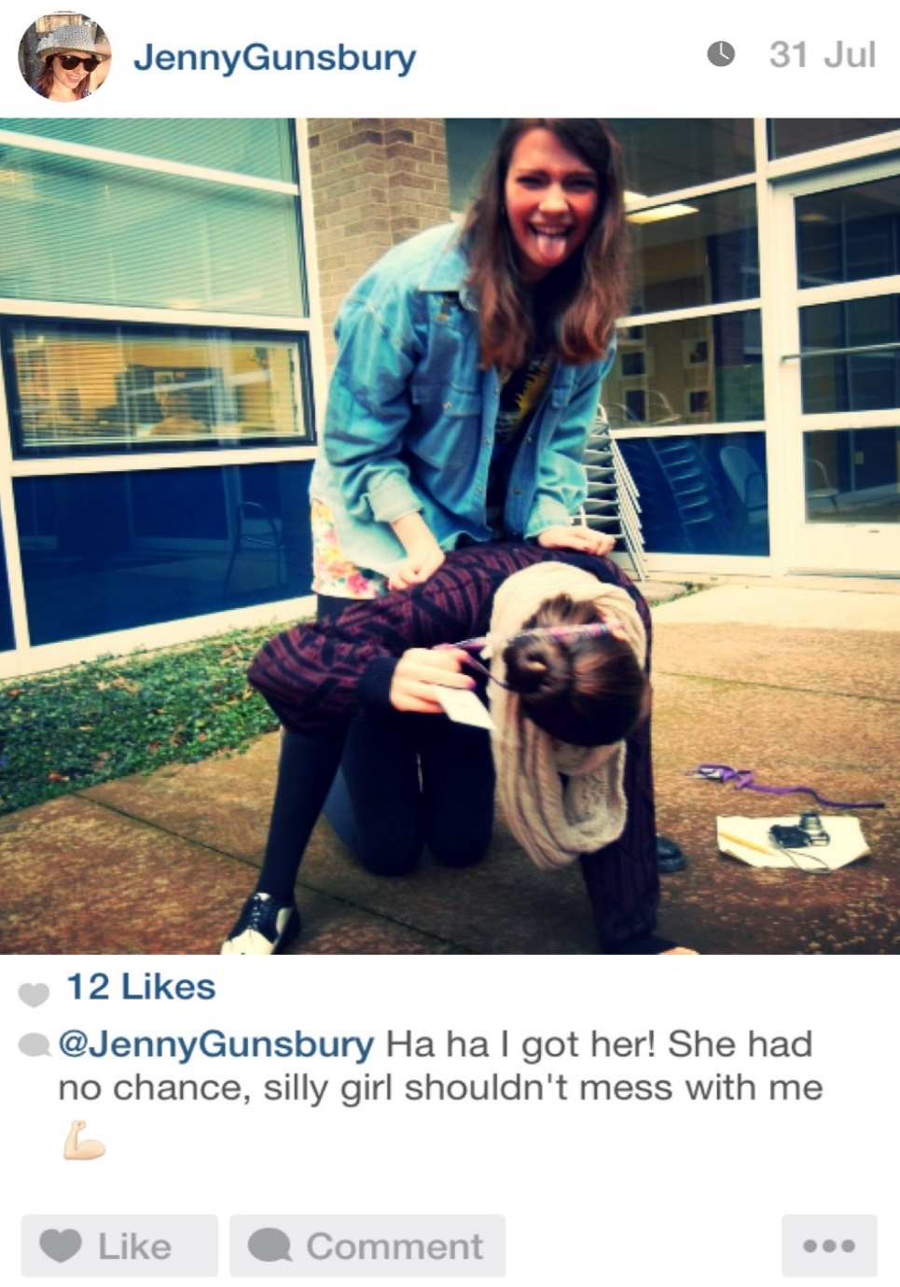

Slide 18
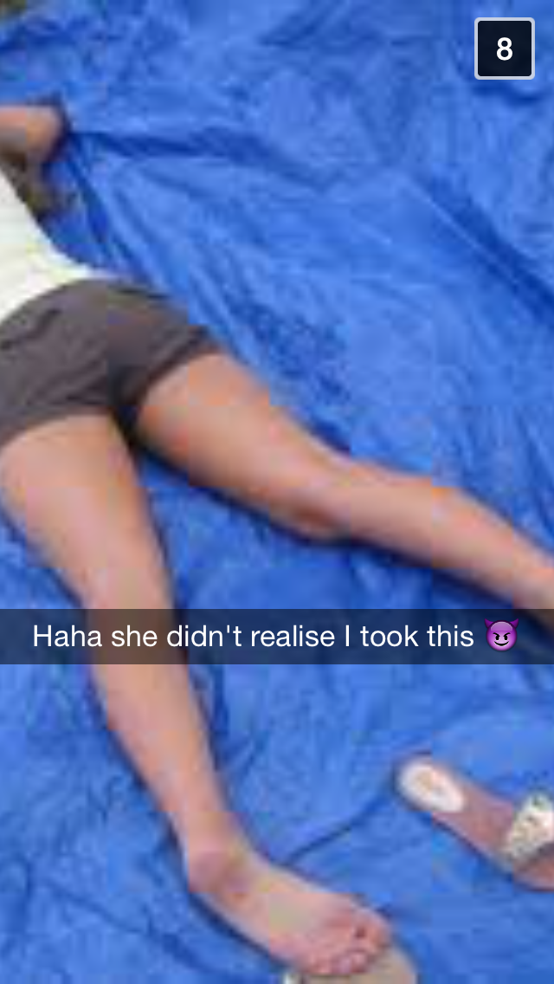

Slide 19
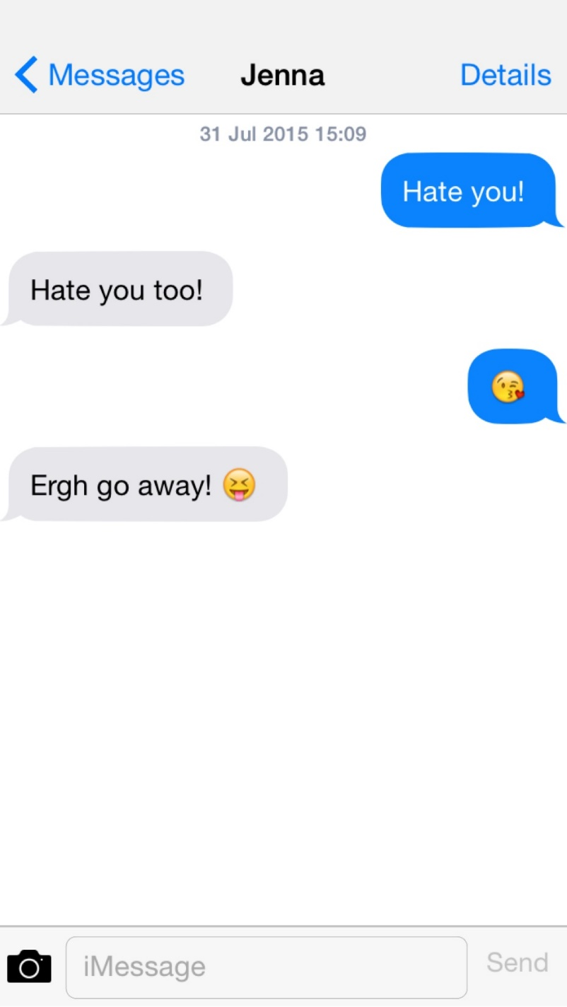

Slide 20
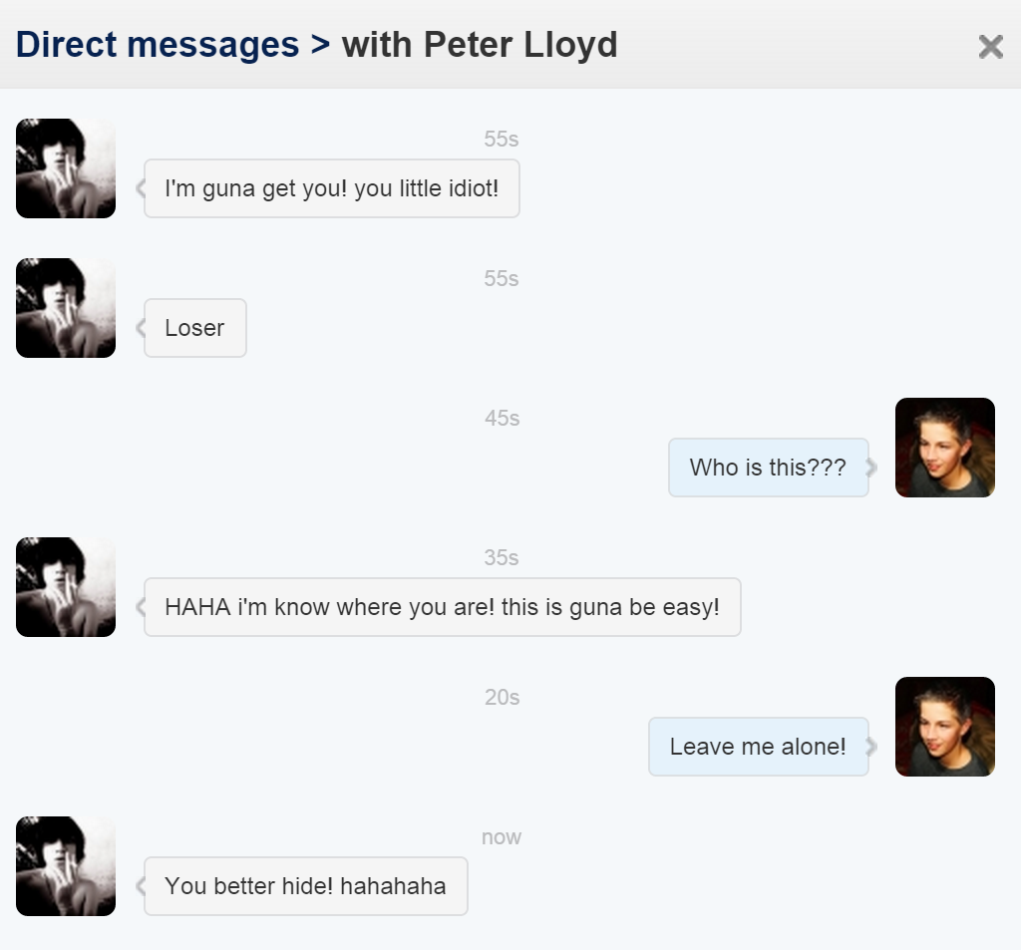

Slide 21
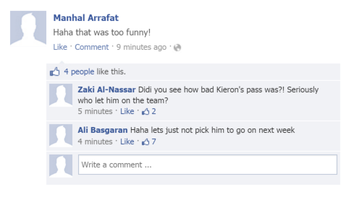

Slide 22
Do we still agree with our cyberbullying definition?
Where would you go for help?

