Slide 1
Short-term joint staff training- BULLYING LEAVES BRUISES INSIDE
„I Am Not a Target!”
2018-1-RO01-KA229-049059
Pafos, Cyprus, 26TH -30TH NOVEMBER 2018
-Gymnasio ”Agias Paraskevis” Geroskipou-

Slide 2
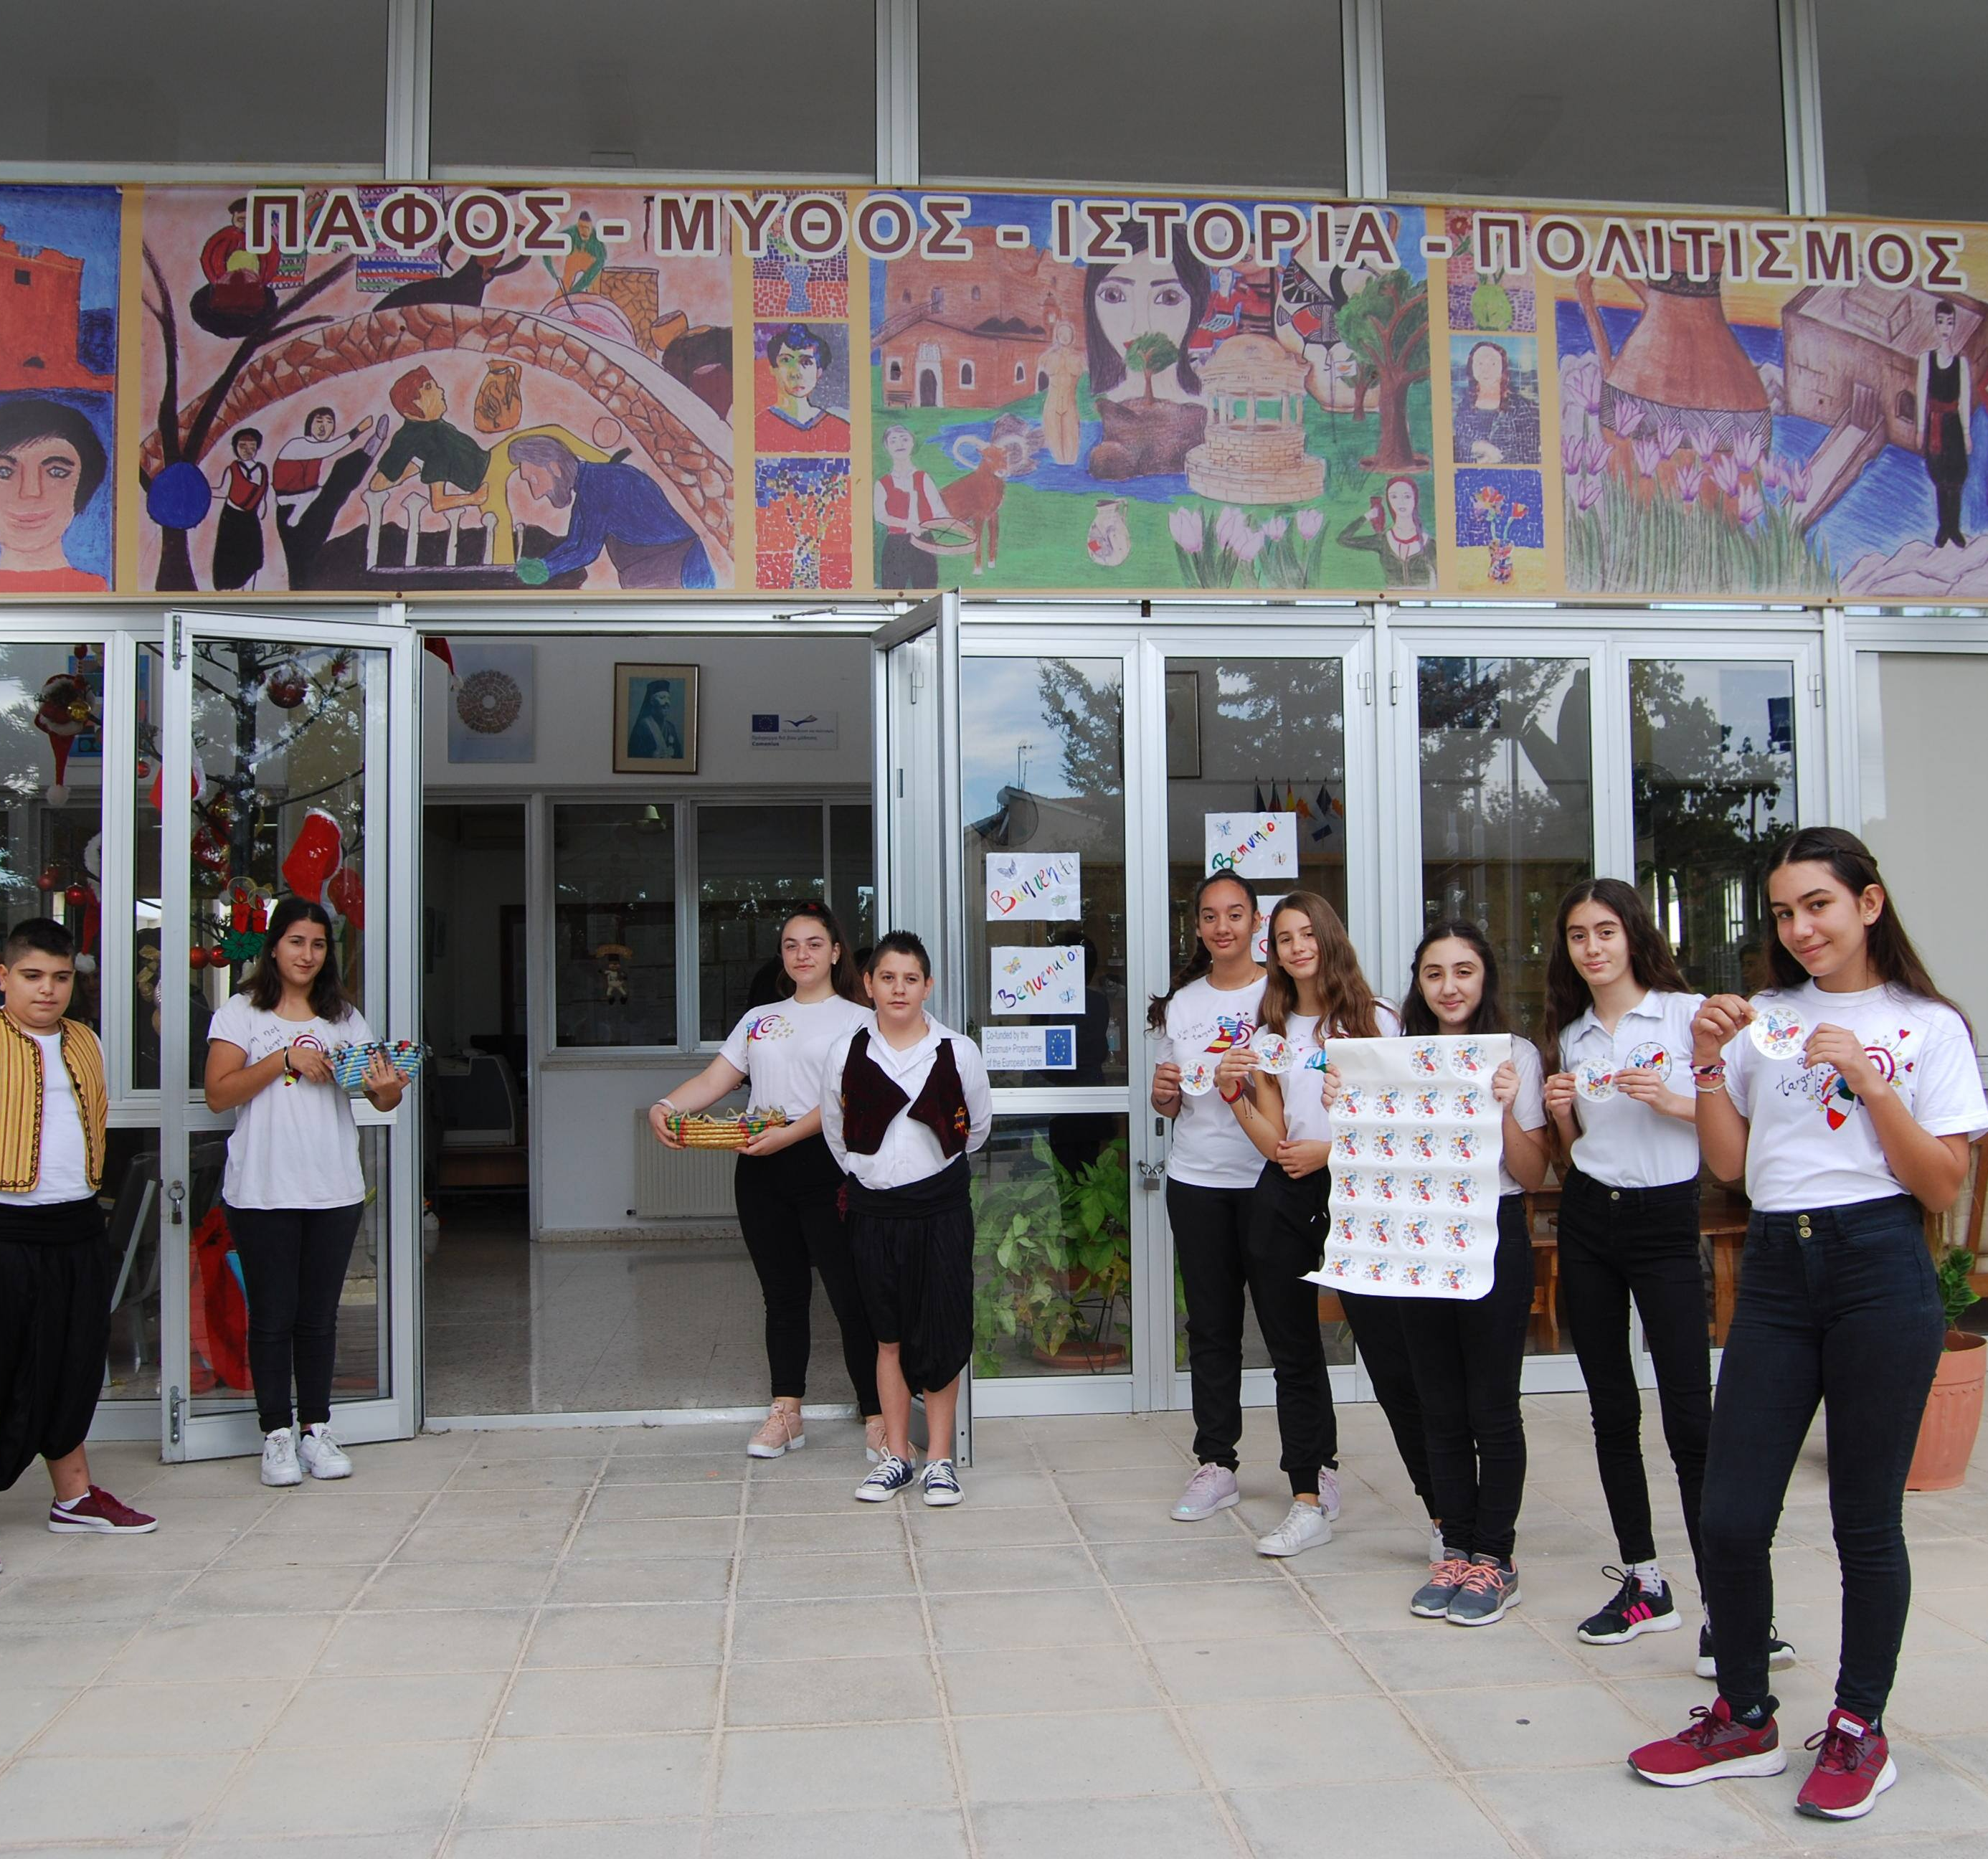
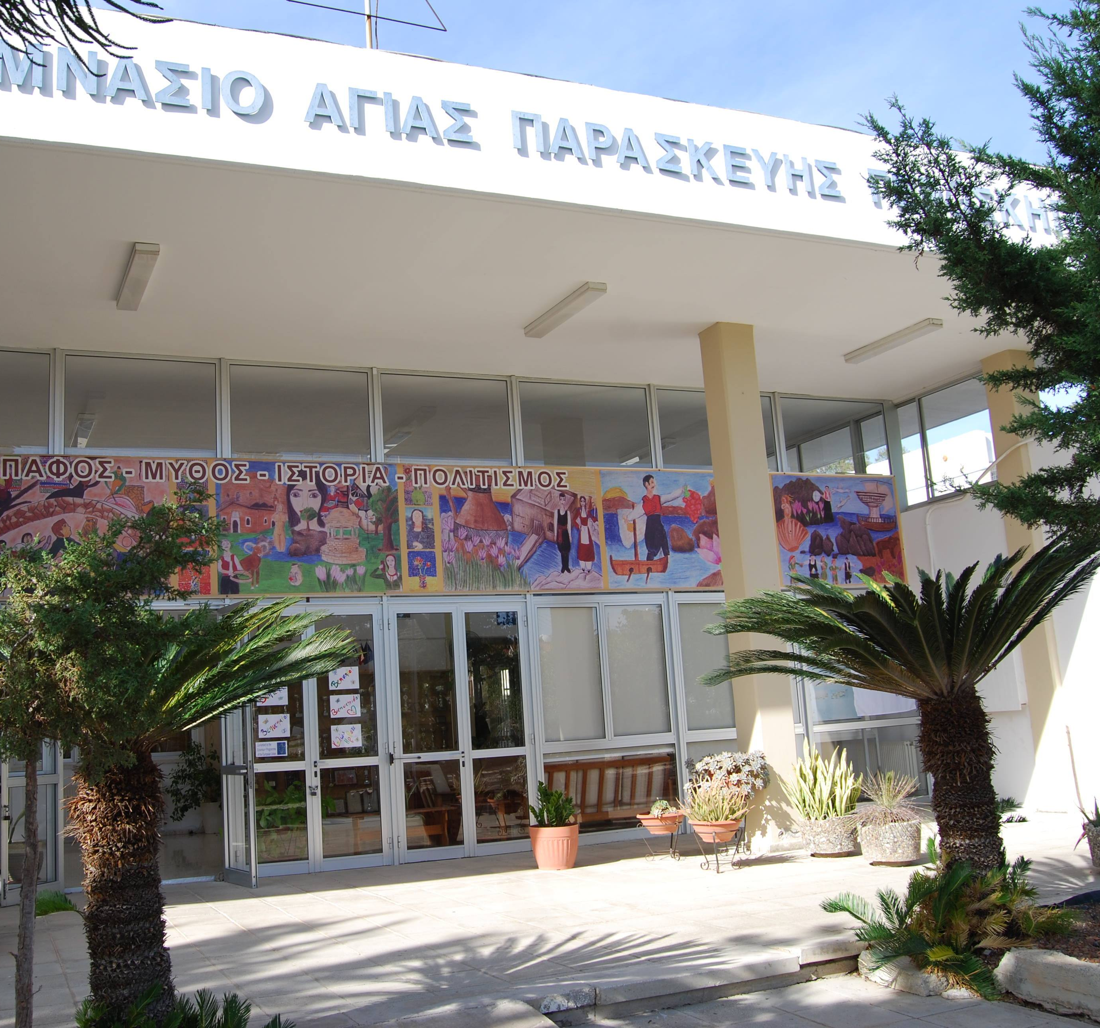
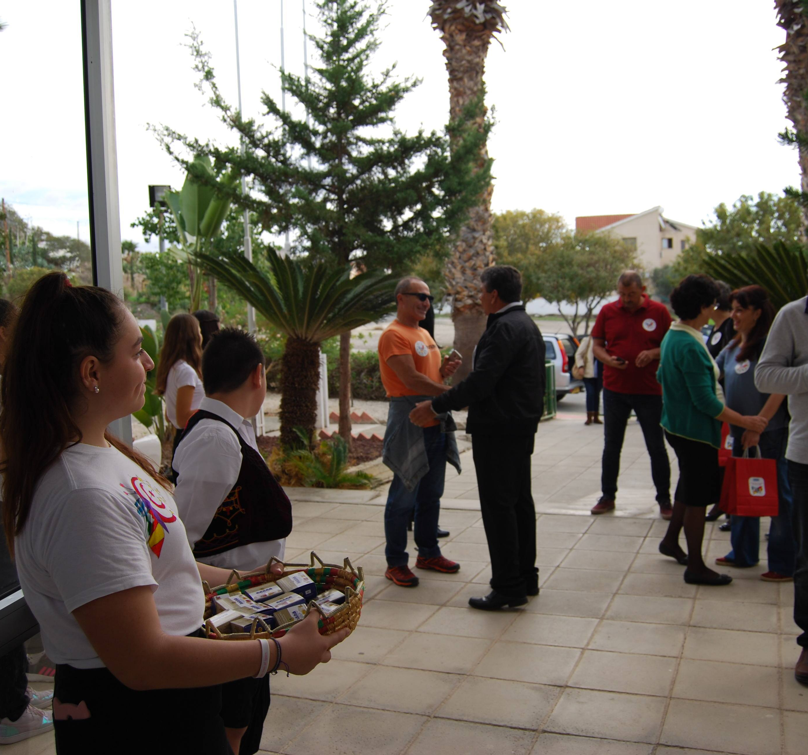
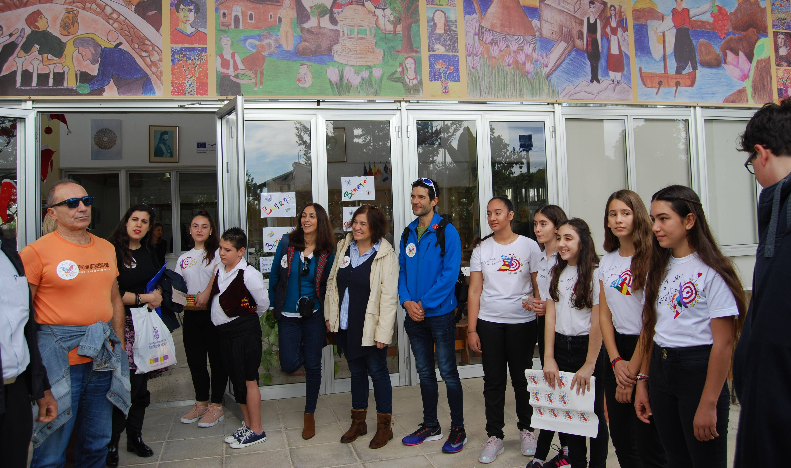
ICE BREAKING SESSION
Welcome meeting in the school

Slide 3
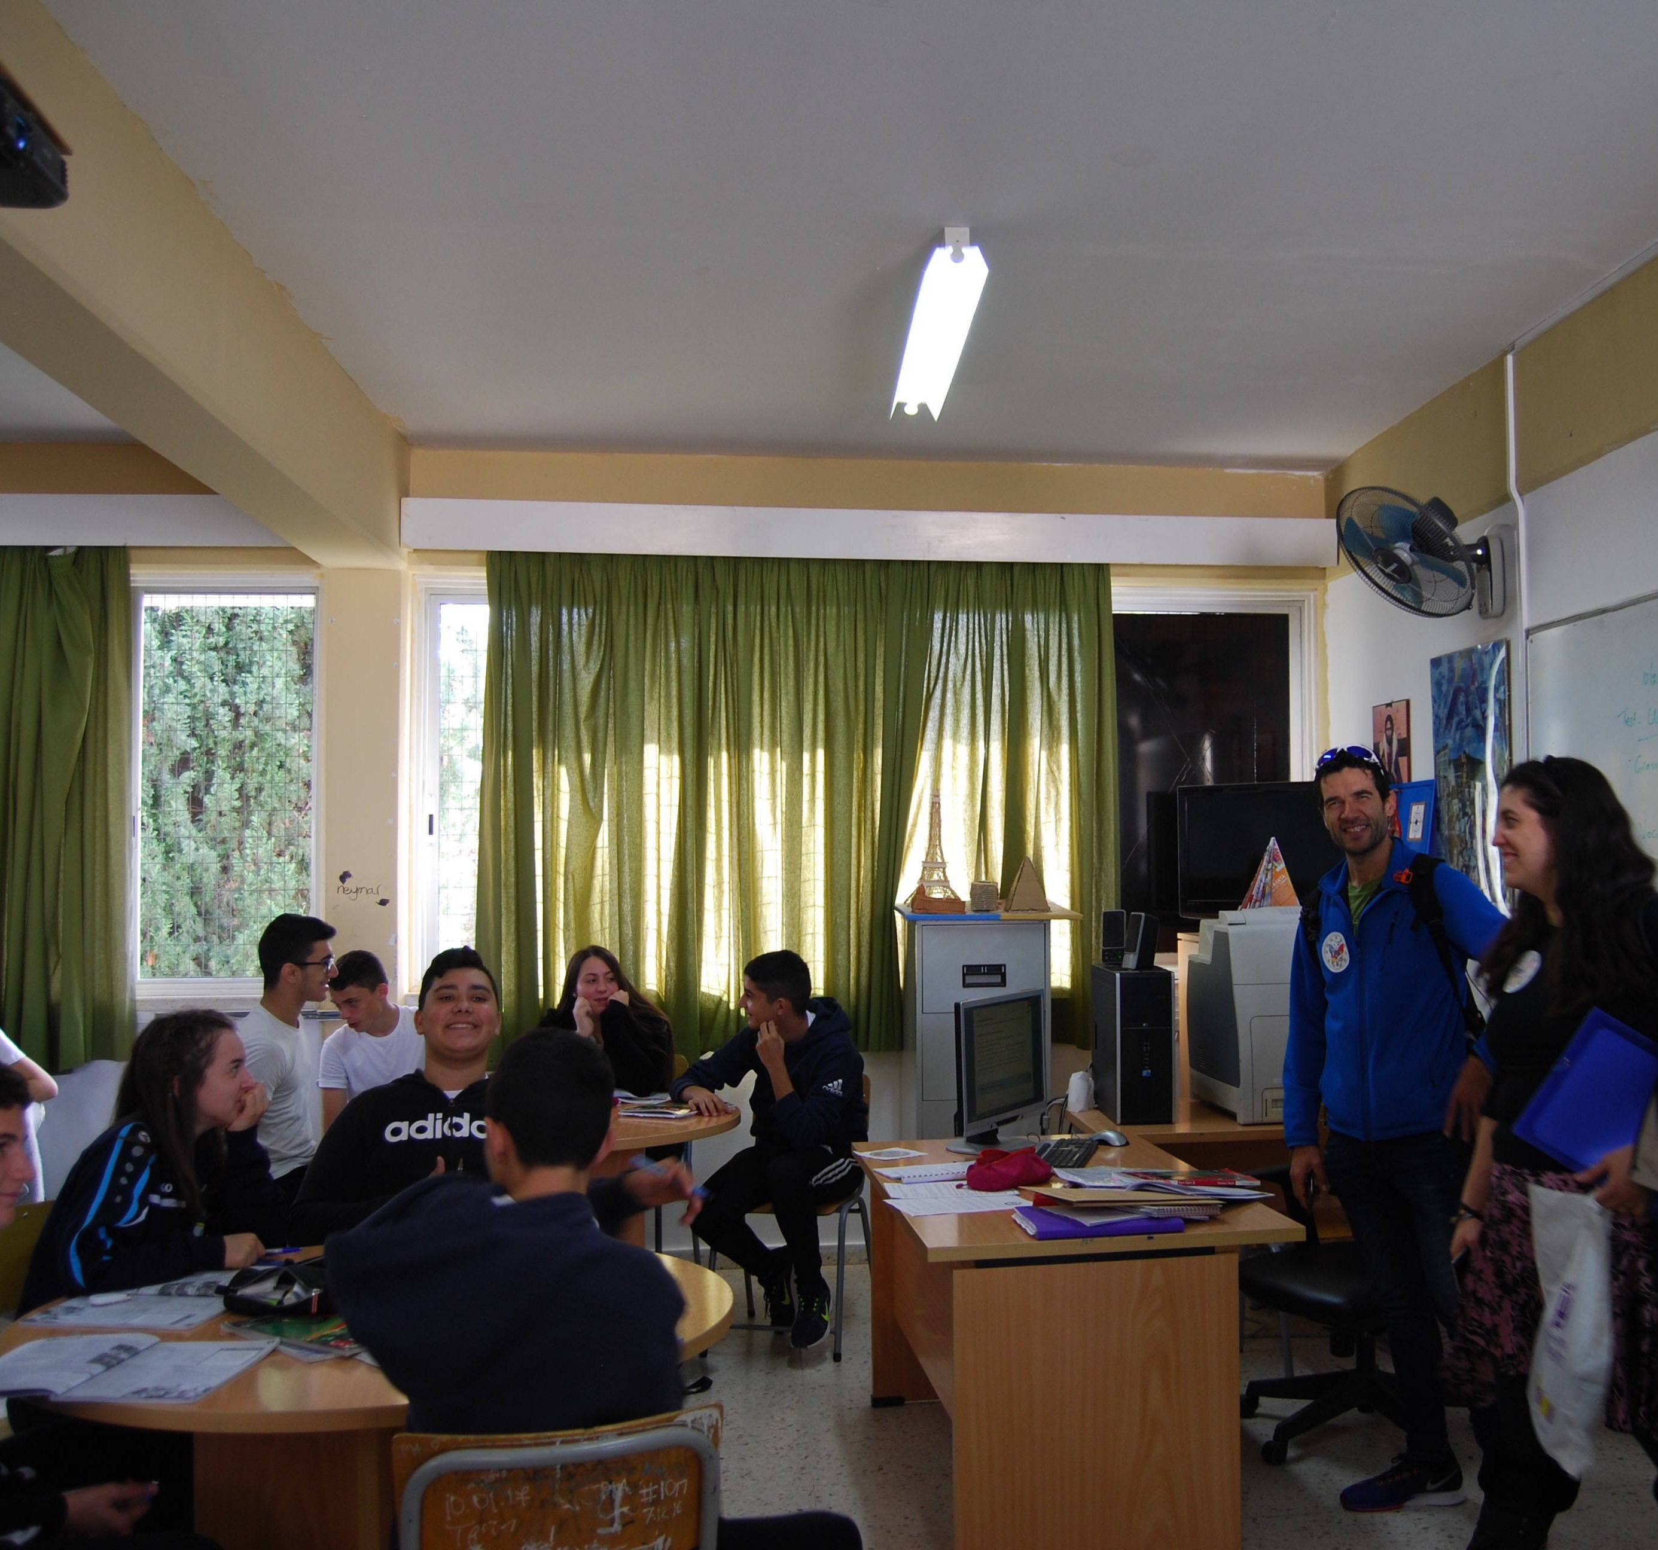
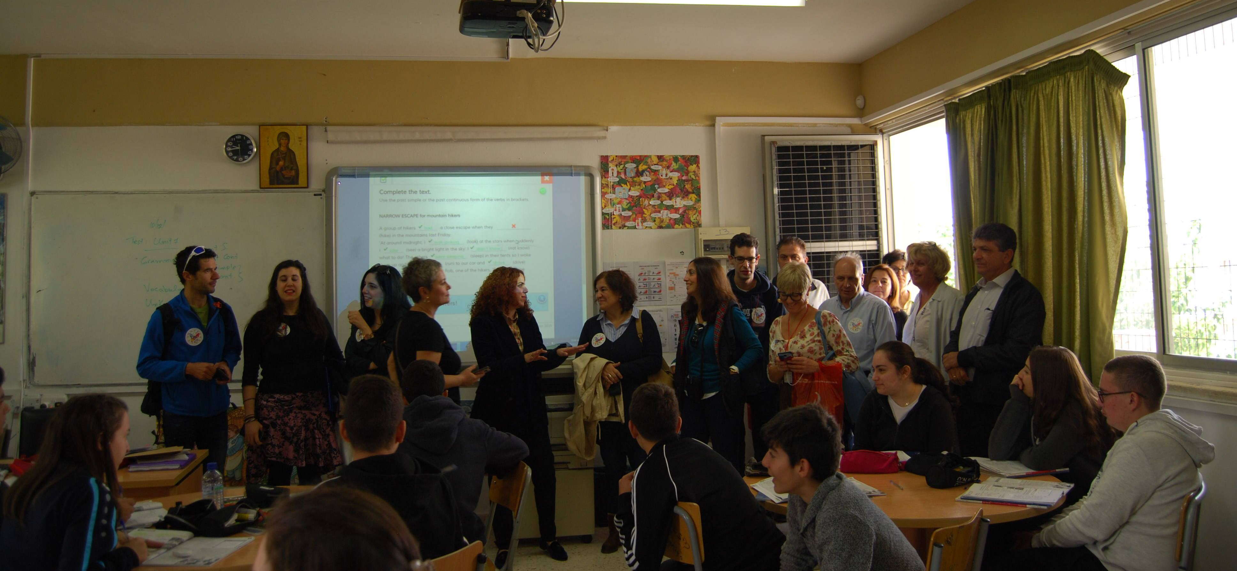
Erasmus friends have been informed about the school life

Slide 4
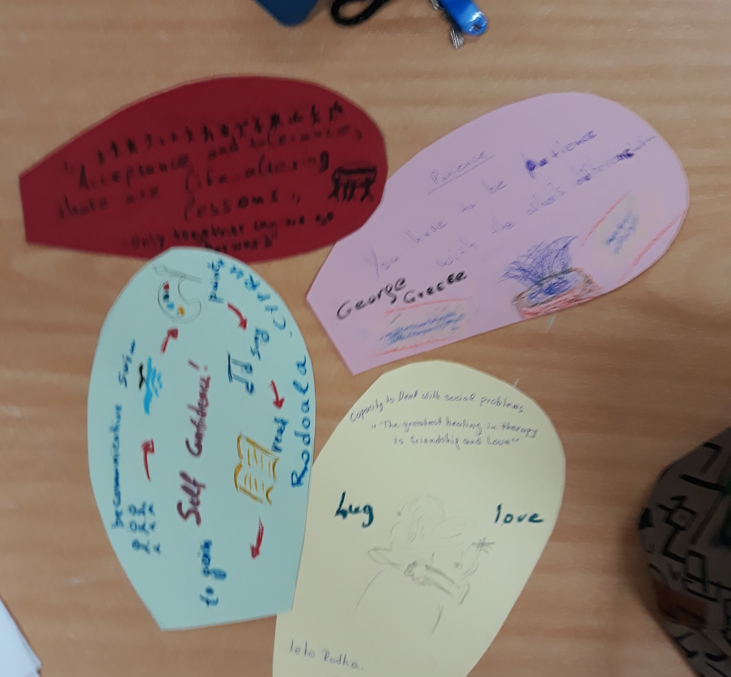
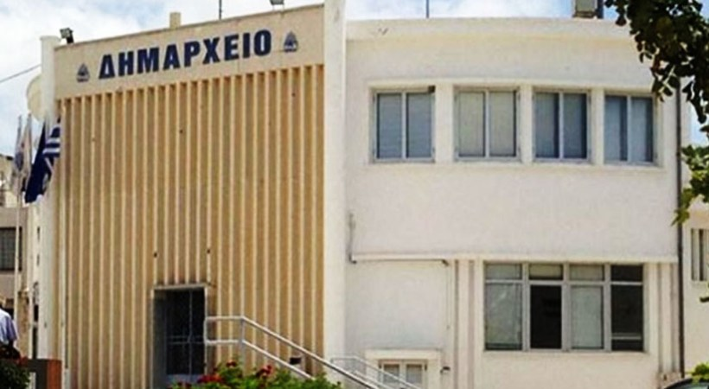
Working program with photo hunting rules

Slide 5
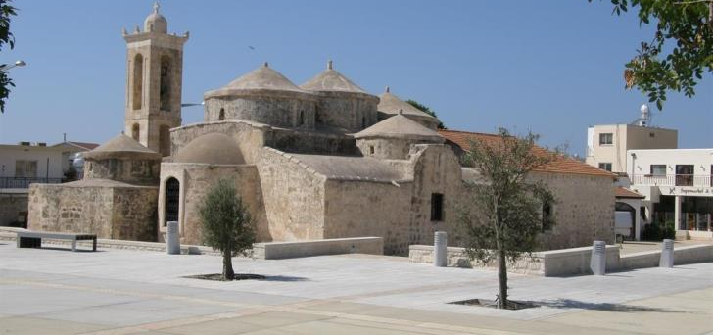
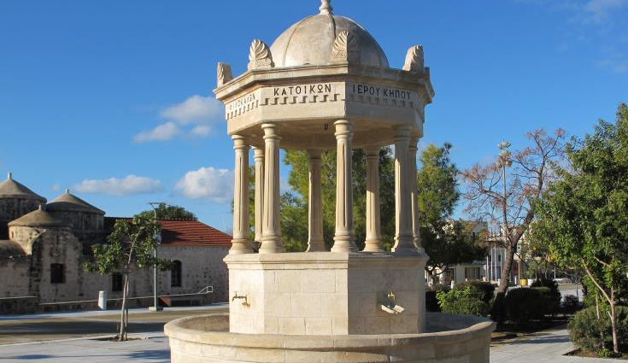
Geroskipou village
Guided tour in the center of the village

Slide 6
AFTERNOON activity -visc
Sharing good practices from Cyprus- the socioecological anti-bullying program “ViSC- Together Against Violence”- presenting the design and results of the project at national and local level

Slide 7
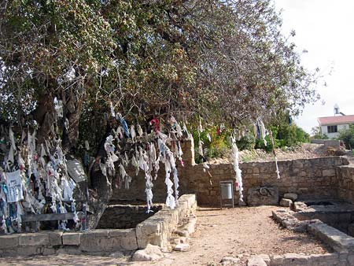
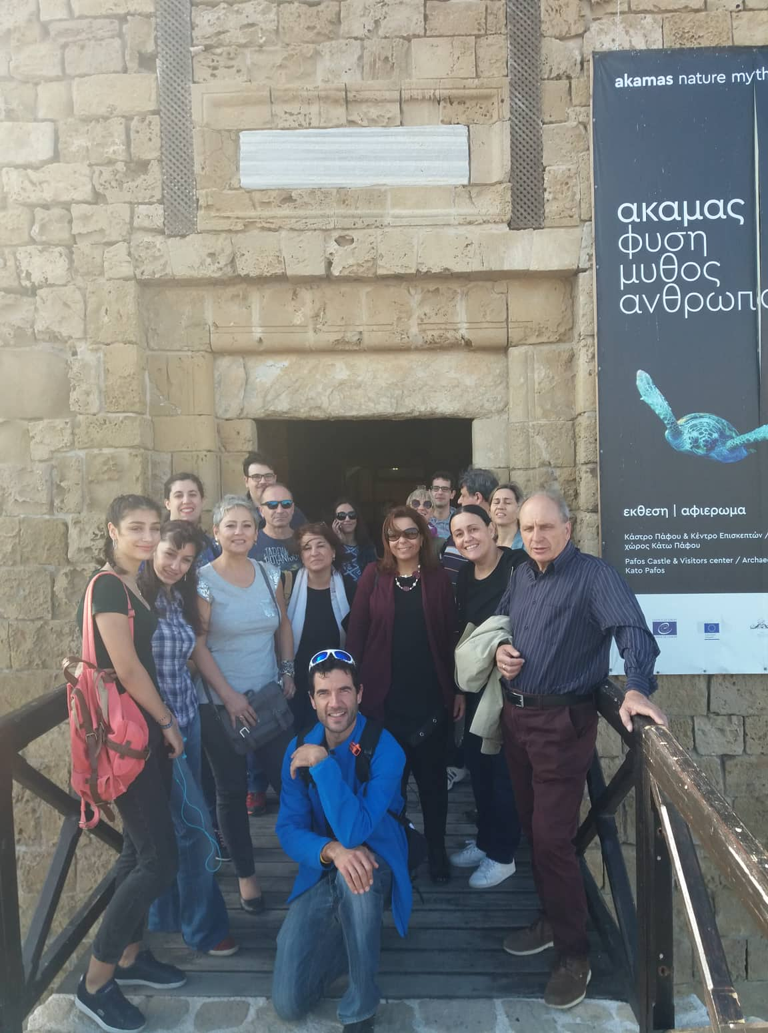
TUESDAY 27TH NOVEMBER 2018
A guided tour to Kato Paphos
A quest notice the multicultural context of paphos

Slide 8
AFTERNOON workshopS
Workshop1: The Cyprus coordinator identifies how diversity affects the classroom

Slide 9
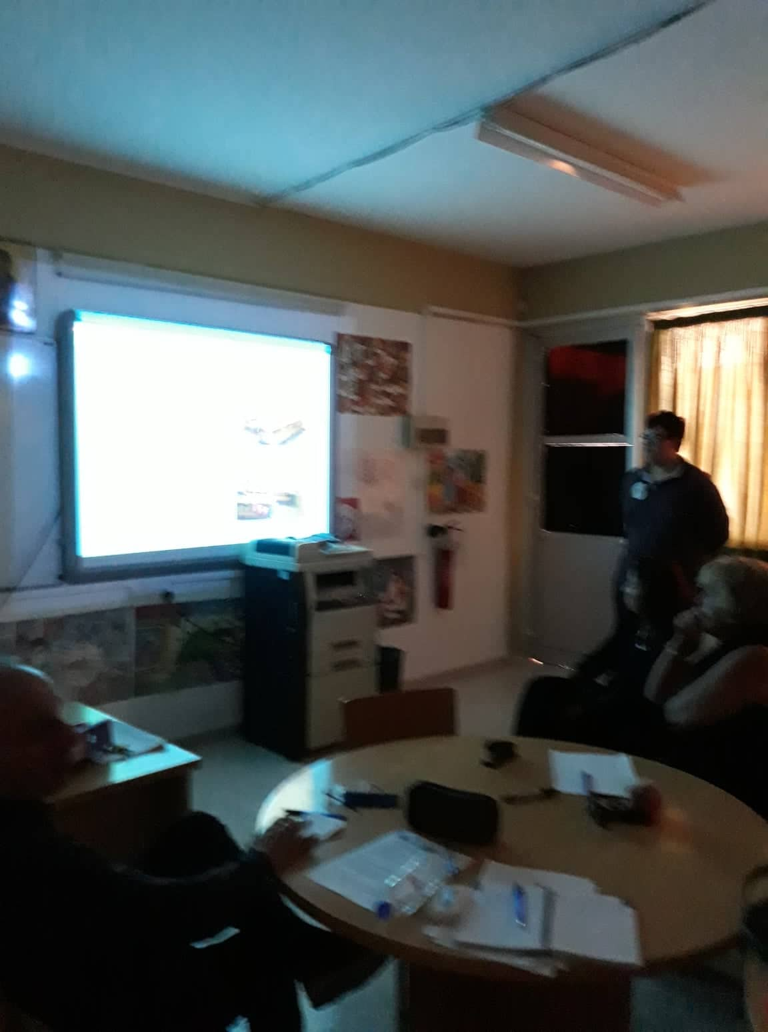
Workshop 2: Diversity and internationalization in scholar environment
Strategies for integrating and including diversity in the classroom

Slide 10
workshop 3
Emotional intelligence and socio-emotional learning
A flower with 15 petals has been constructed to focus on teaching process

Slide 11
Wednesday 28TH November 2018
Participants share experiences of bullying in schools as base for the identification of some activities for bullying prevention in scholar environment

Slide 12
Workshop 4
External partner Christos uses some very interactive and interesting strategies for reconstructing stereotypes around bullying

Slide 13
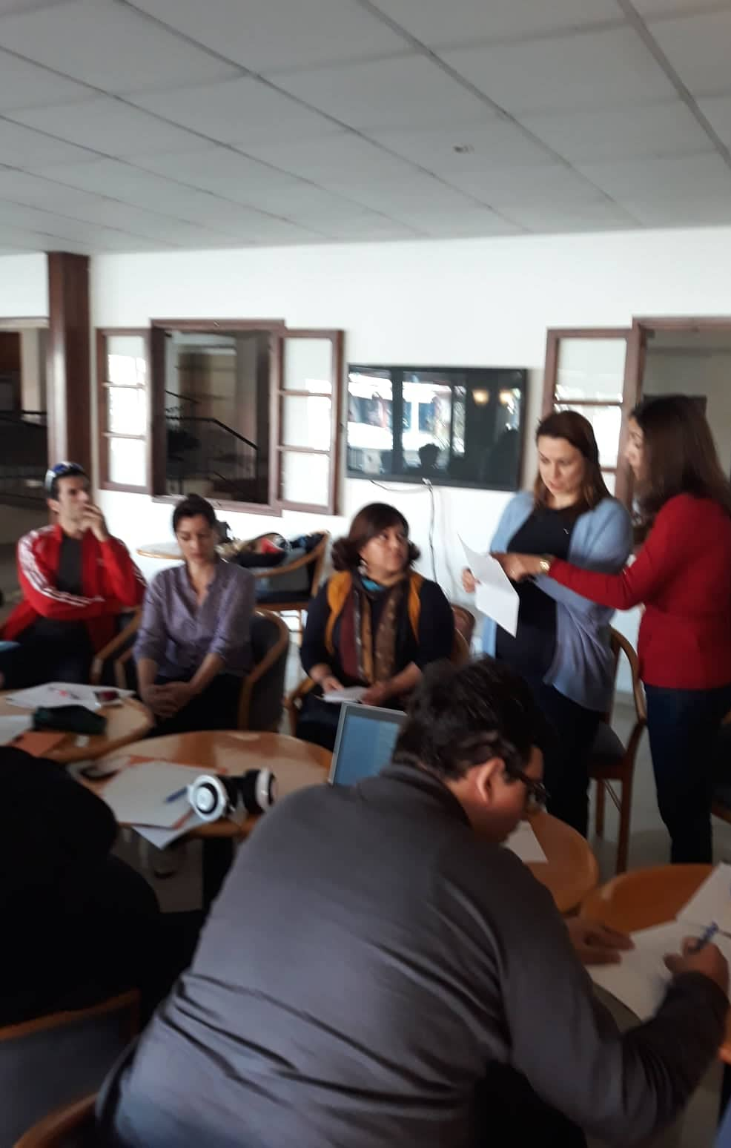
Thursday 29th November 2018
The teams present their lyrics ,from the Wednesday morning, and put them together
Discussion about the creation of Kahoot quiz of Kahoot platform

Slide 14
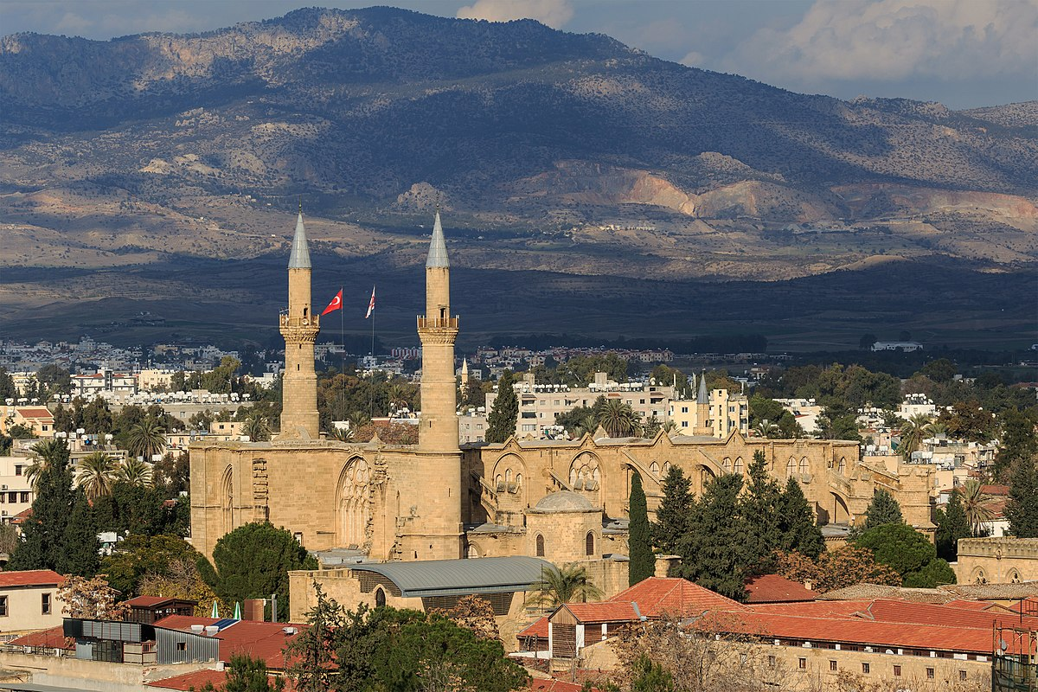
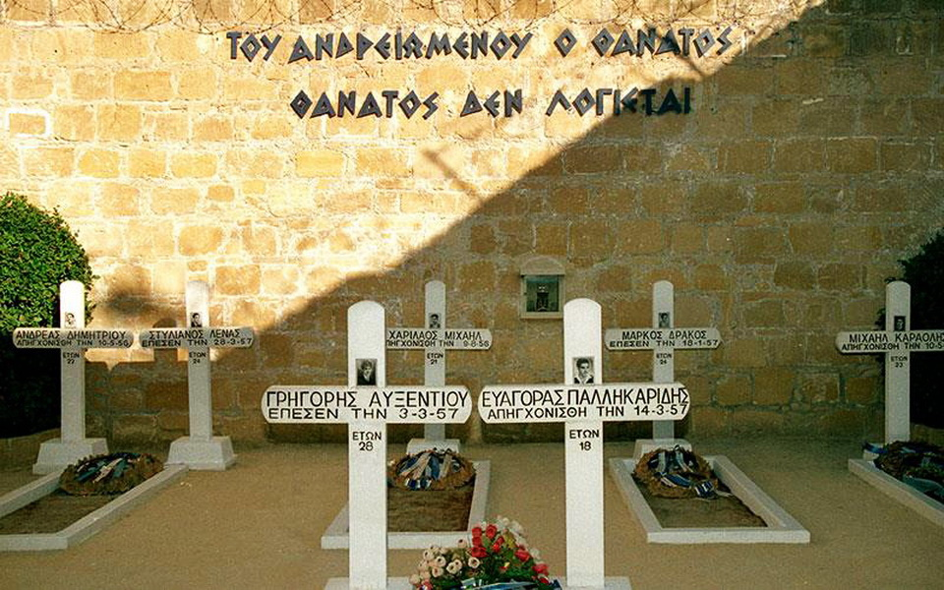
A trip to Nicosia
A city that will reward visitors in search of something different
One can be charmed by the manner in which past and present have seamlessly fused together

Slide 15
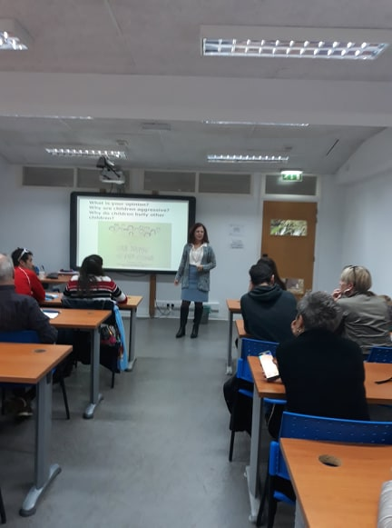
FRIDAY 30th NOVEMBER 2018
Workshop 5: Learning design and creation of e-learning instruments.
Participants share kahoot quizzes and play parts.
Workshop 6: Dr Olga Koundouri presents more details about VISC

Slide 16
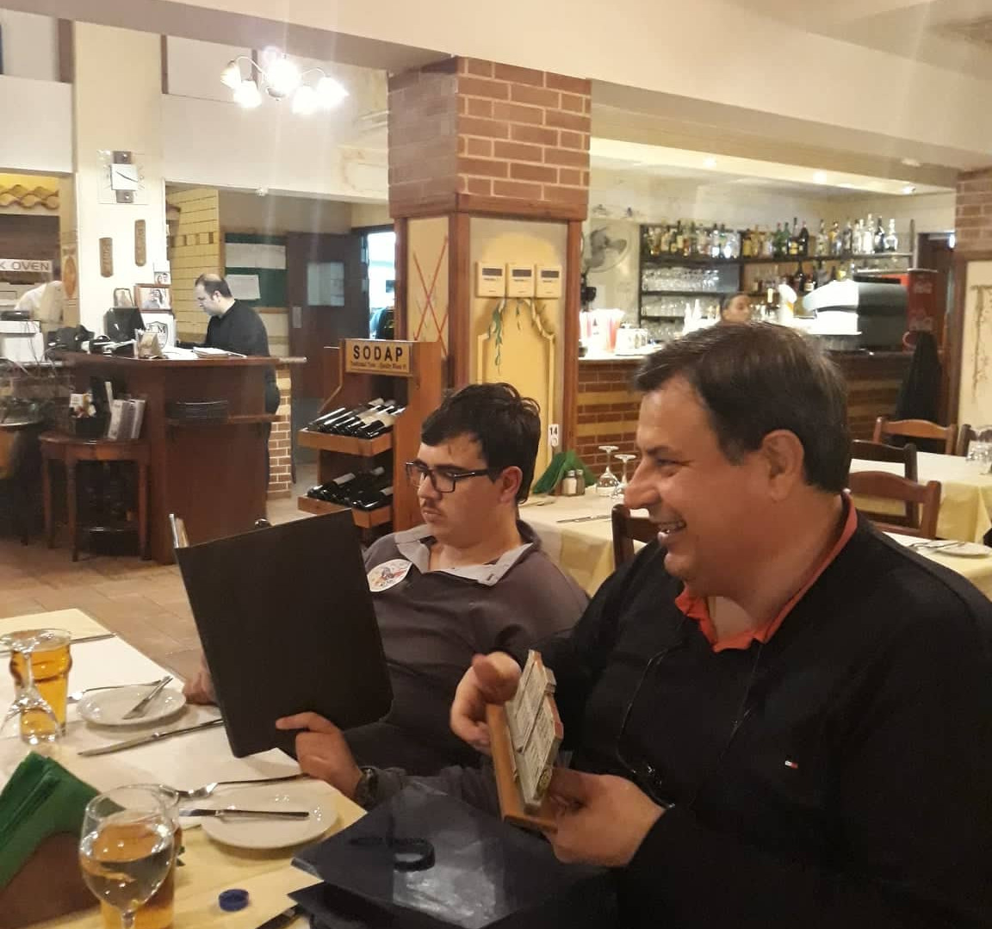
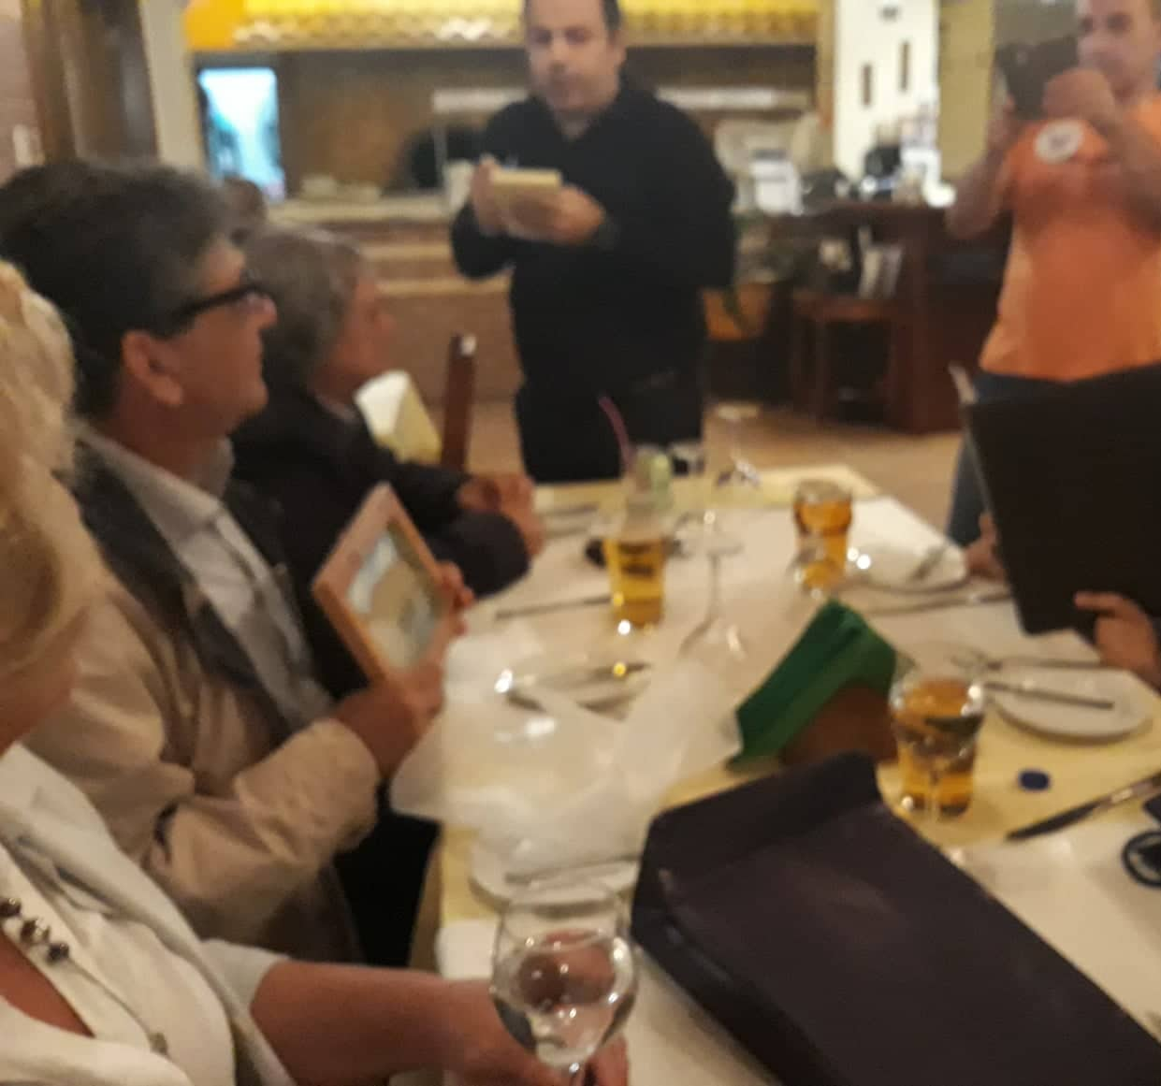
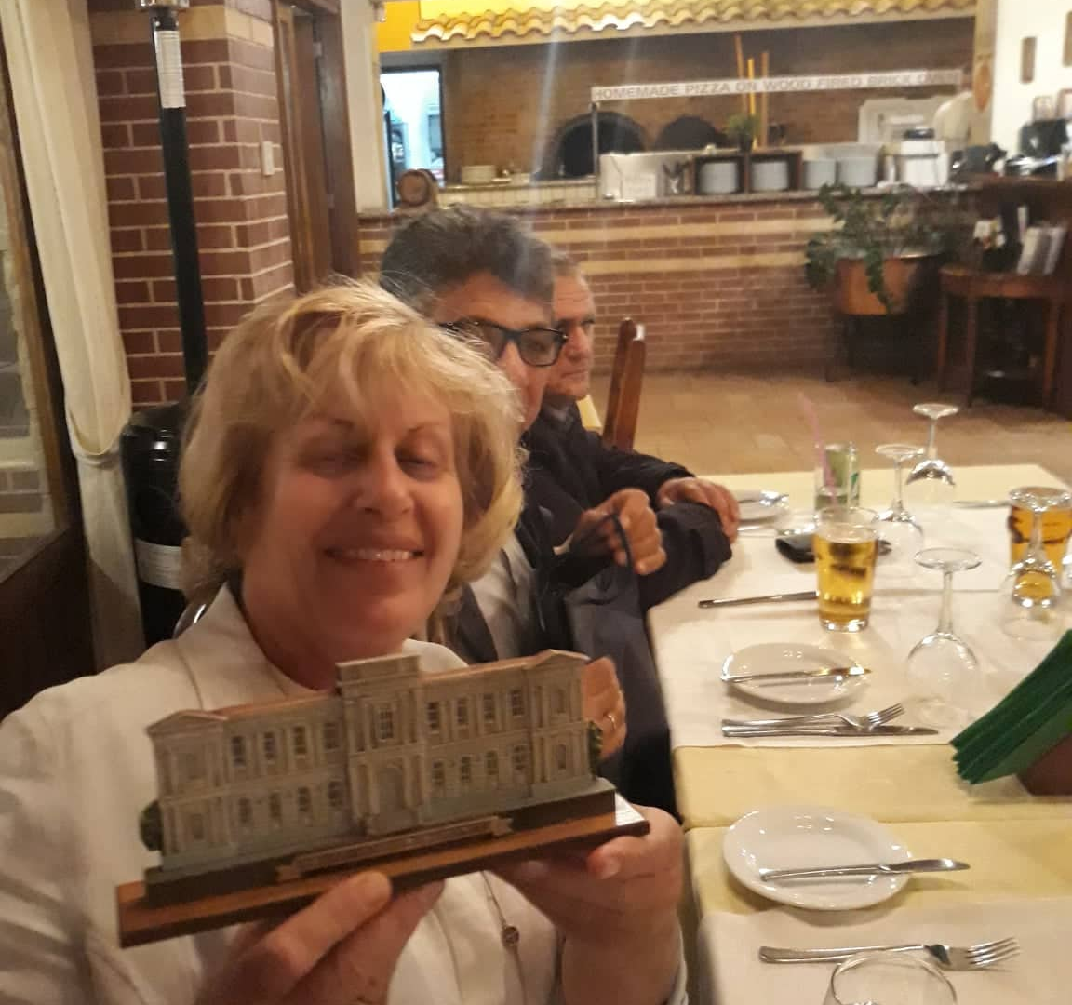
The meeting ends with a farewell dinner at the hotel!!!!

Slide 17
Disclaimer
This material it is produced with the financial support of European Commission and Erasmus+ program. Its content (text, photos, videos) does not reflect the official opinion of the Program Operator, the National Contact Point or European Commission. Information and opinions which are here expressed
are the exclusive responsibility of the author/s.

