Slide 1

PROJETO ERASMUS +
“I AM NOT A TARGET”
ETWINNING EVENTS:
Shares of Good Practices in Cyprus
Agrupamento de Escolas Emídio Navarro
EB da Cova da Piedade
Portugal

Slide 2
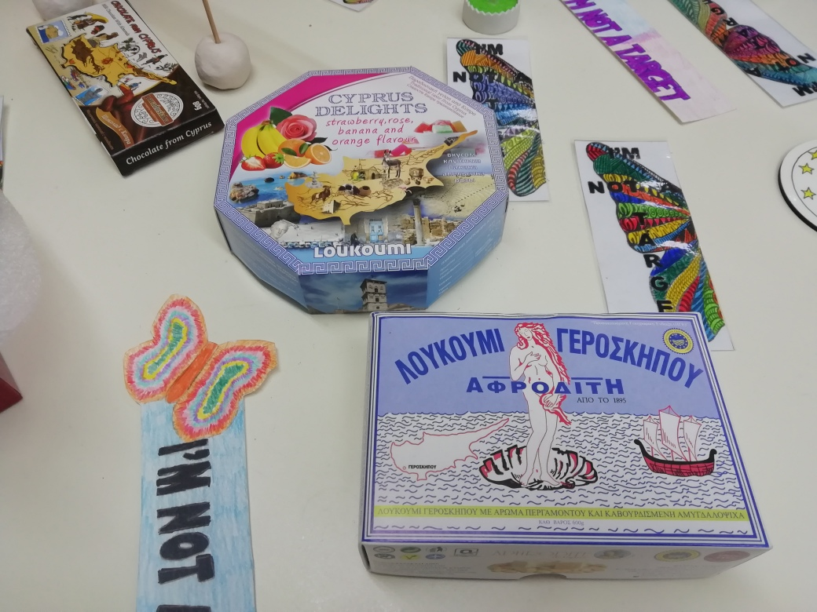
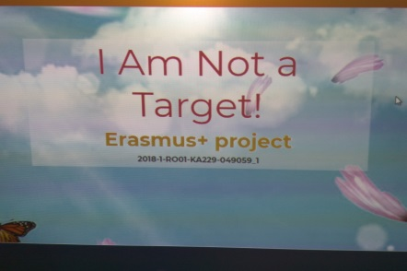
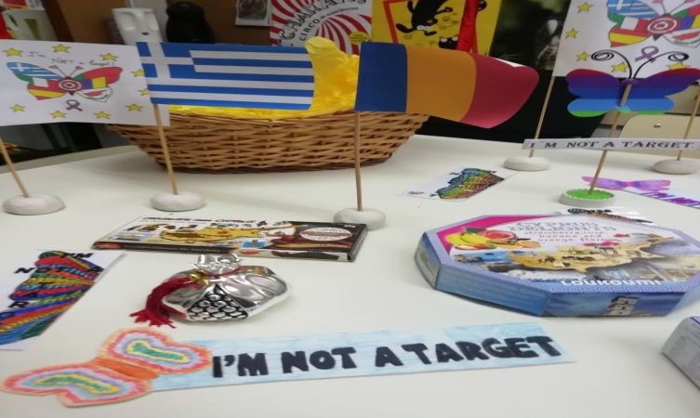
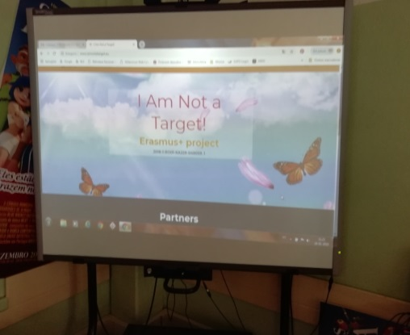
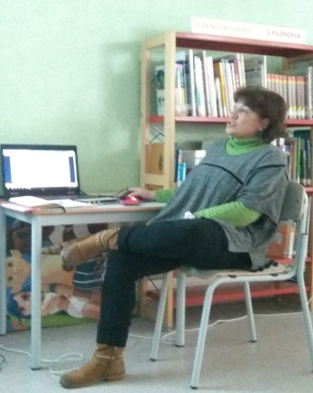
Part 1: Brief introduction, with a passage from a power point on Mobility to Cyprus.

Slide 3
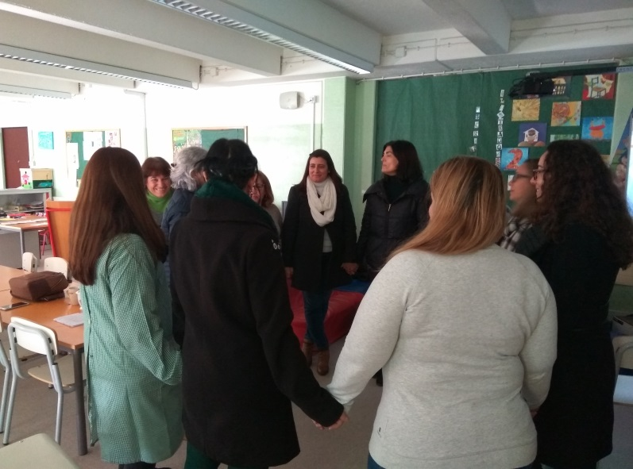
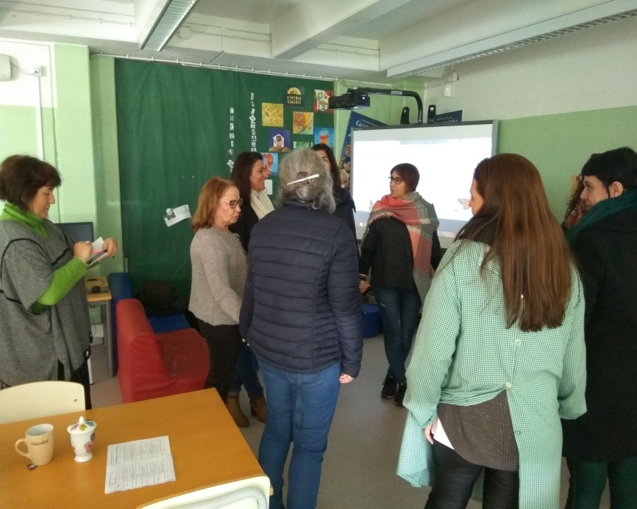
Se
Part II : Practical Activities developed in Cyprus and shared with our school colleagues.
First Activity: Collage of stickers of different colors on the back of the participants…

Slide 4
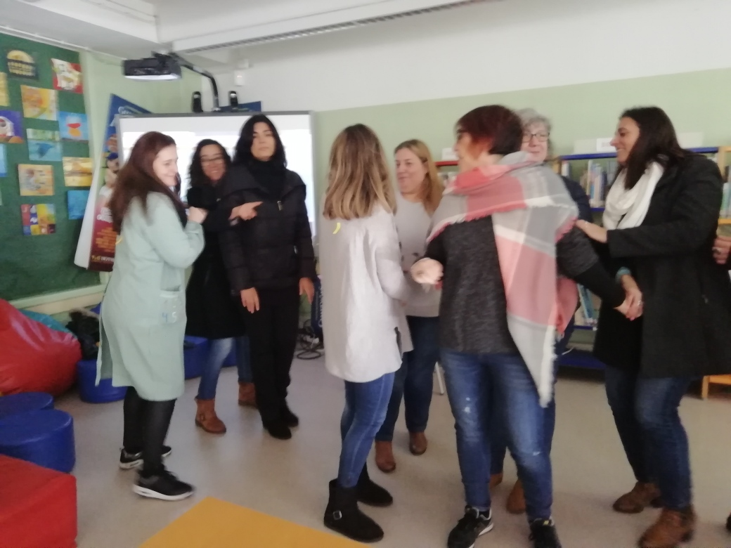
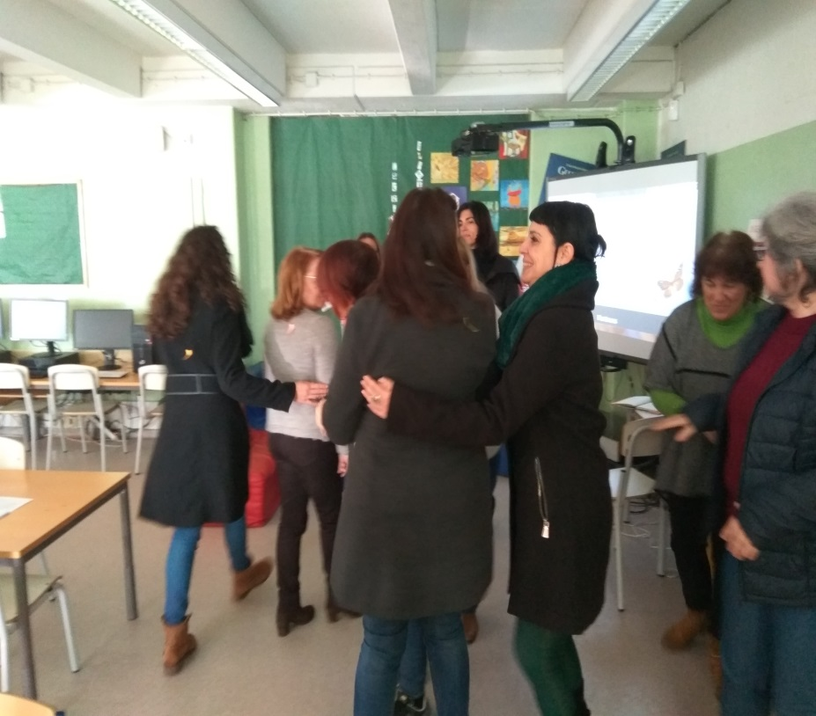
Grouping according to the color of the sticker…

Slide 5
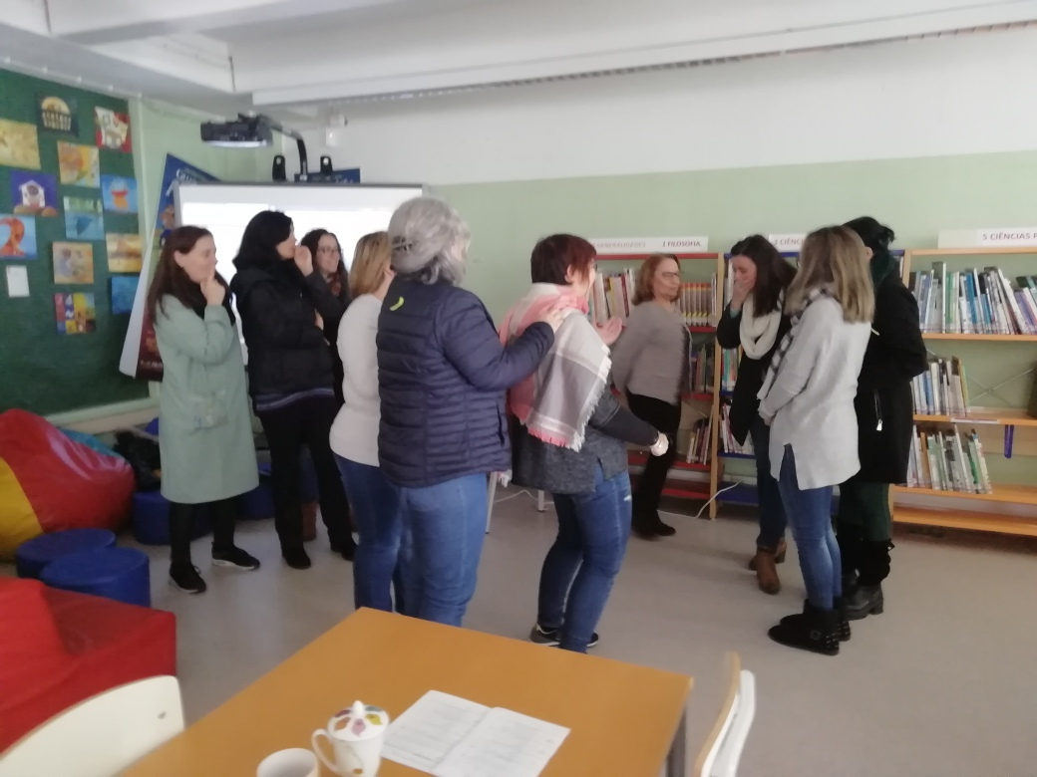
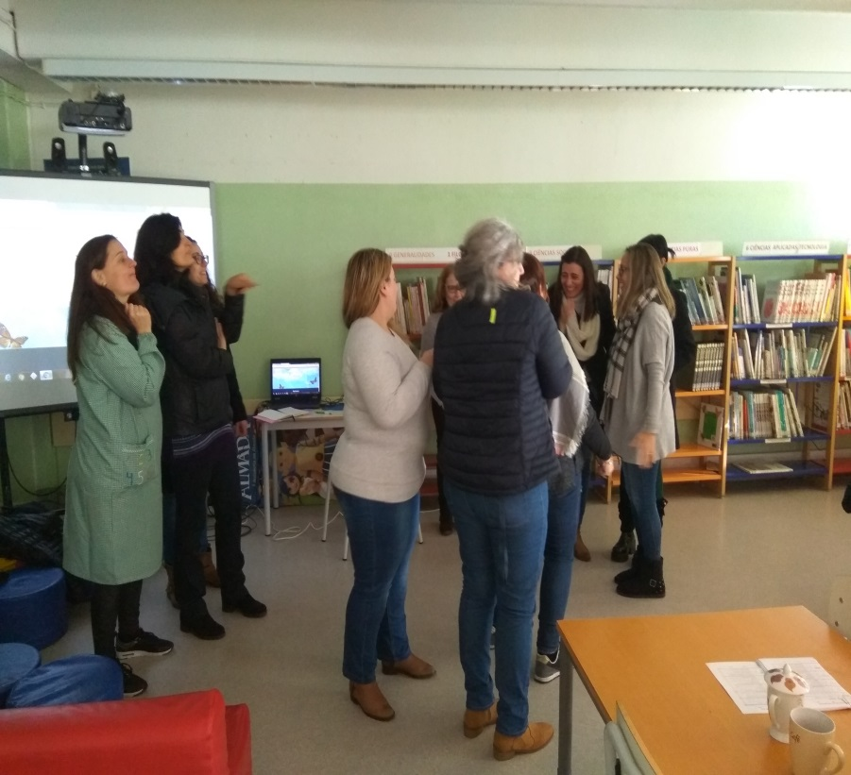
What happens when someone is left alone?
How does the person who is not chosen feel?
This activity is very interesting to be developed with our children.

Slide 6
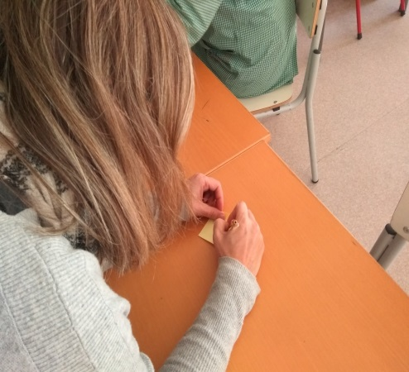
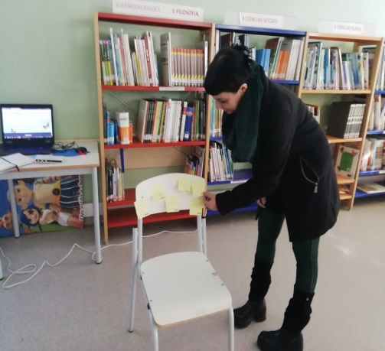
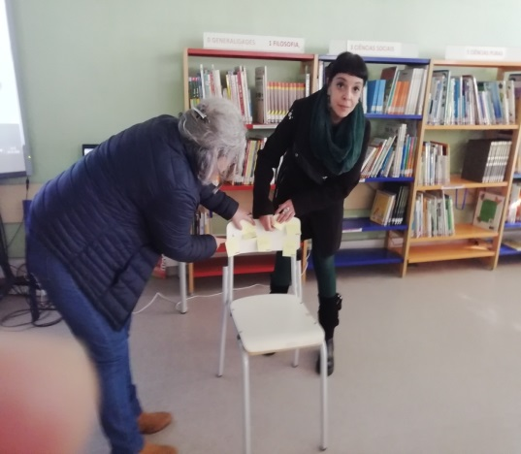
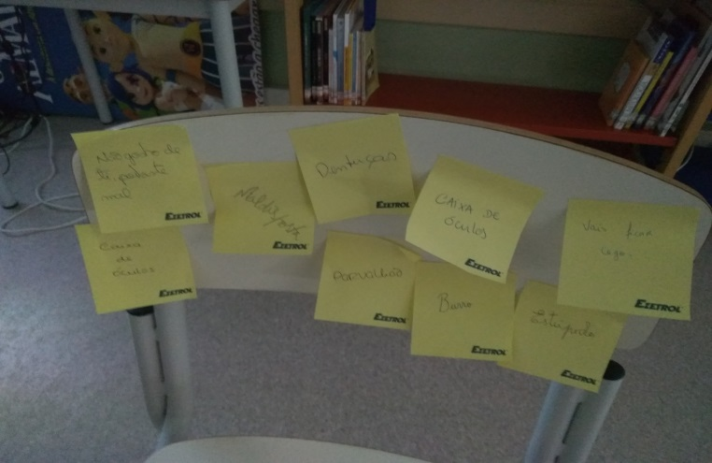
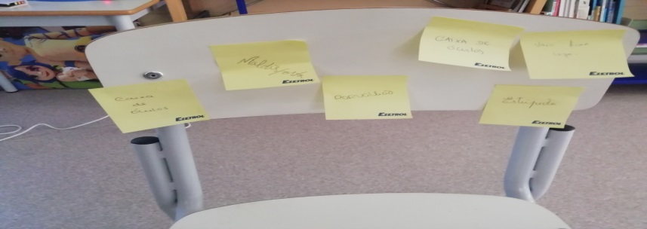
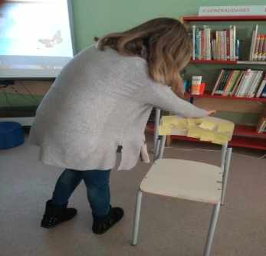
Second Activity: Write some unpleasant words or expressions on a paper and stick them on a chair…

Slide 7
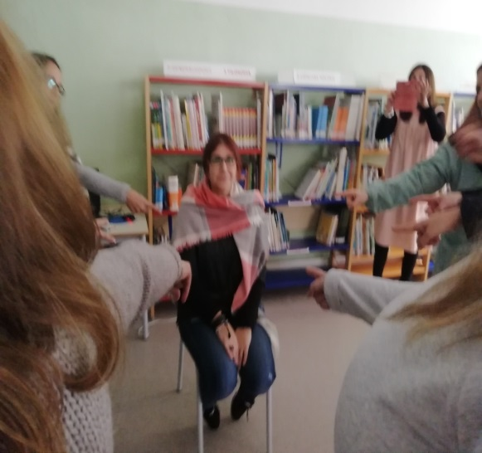
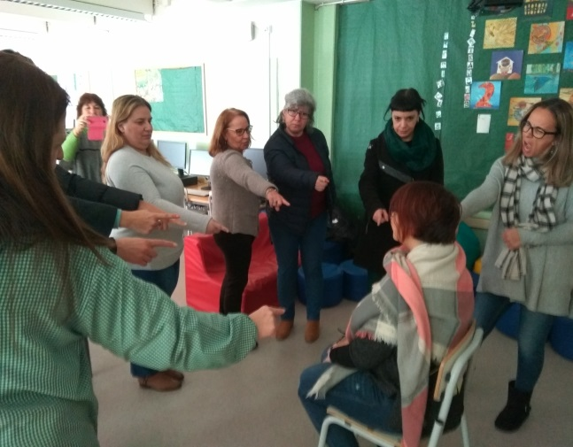
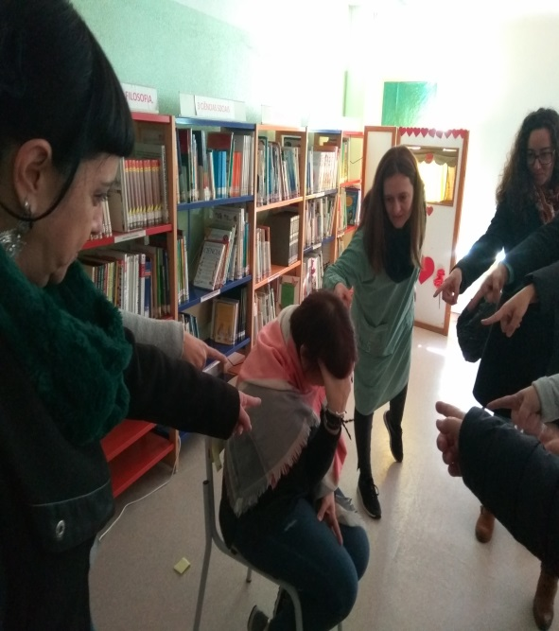
What if someone sits on the chair, and if those expressions are addressed to a person? How will she feel?

Slide 8

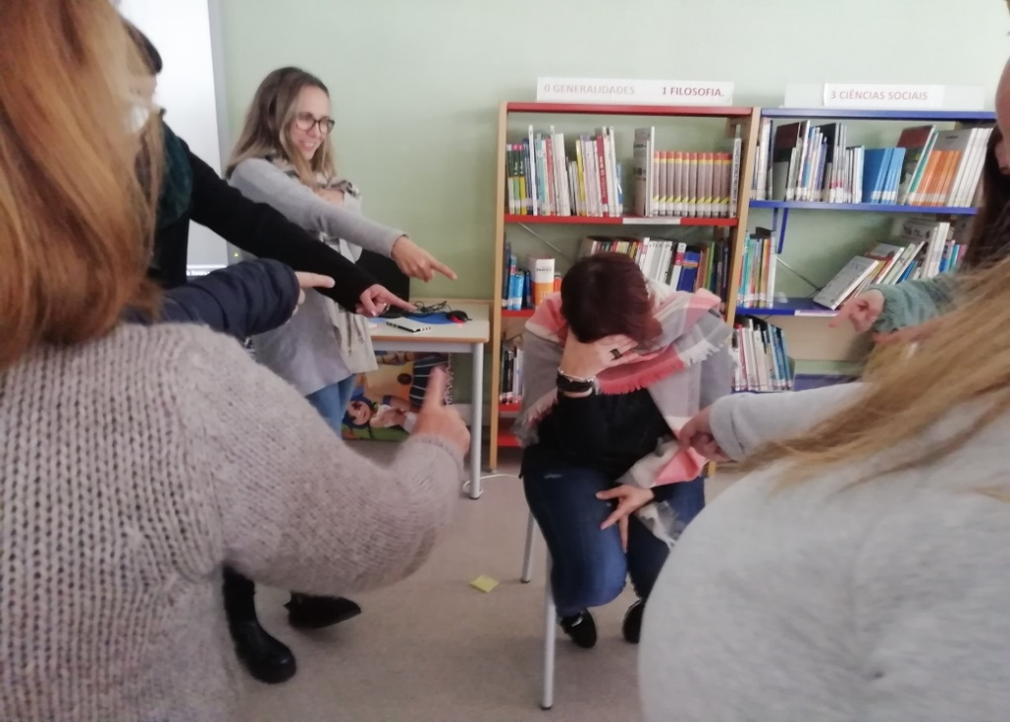
This is another very interesting activity to do with our students, teaching them to create empathy, and know how to put ourselves in the place of the other ...

Slide 9
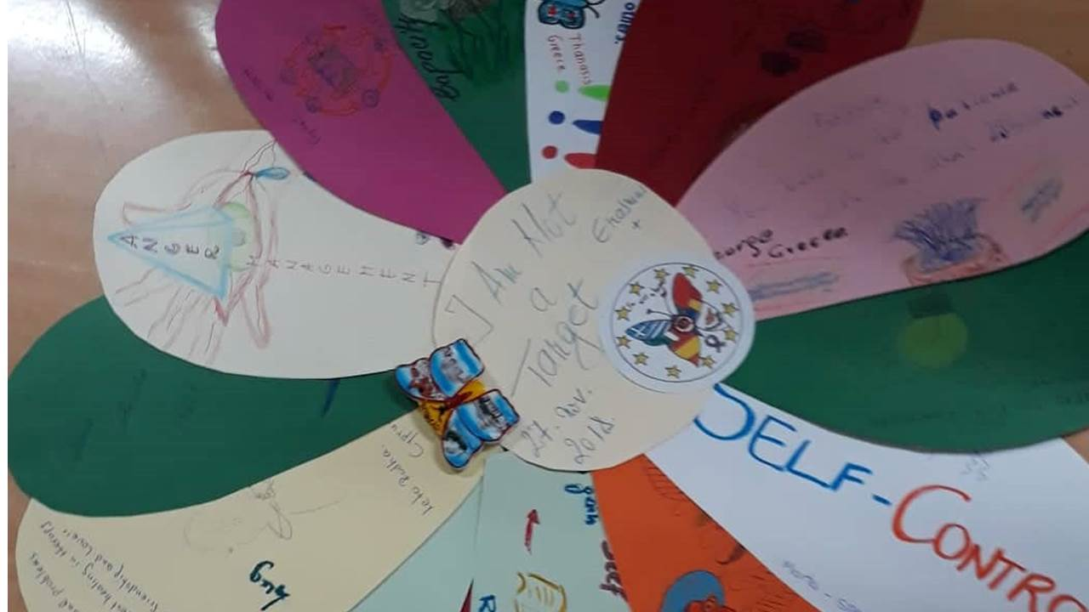
These small activities are a good example of sharing good practices in Cyprus that help us prevent Bullying in our schools.
Let's make the difference ...
EB da Cova da Piedade

